Slide 1
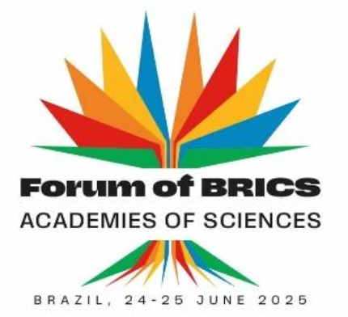

﻿Scientific Aspects of South-South Cooperation and BRICS
Partnerships for Social, Economic and Environmental
Development
Prof. Odir Dellagostin
Federal University of Pelotas
Notes:
“Good morning, colleagues. I’m Odir Dellagostin, speaking alongside Jorge Guimarães. On behalf of the Brazilian Academy of Sciences, thank you for joining us in Rio.
Our theme—Scientific Aspects of South-South Cooperation and BRICS Partnerships for Social, Economic and Environmental Development—asks two big questions:
Where is research power shifting?
How can we translate that momentum into shared prosperity and sustainability?
We will open with data on the dramatic rise of BRICS-Plus science, move to priority collaboration areas—energy, health, AI, food systems—and finish with concrete policy actions for the decade ahead. Let’s get started.”

Slide 2
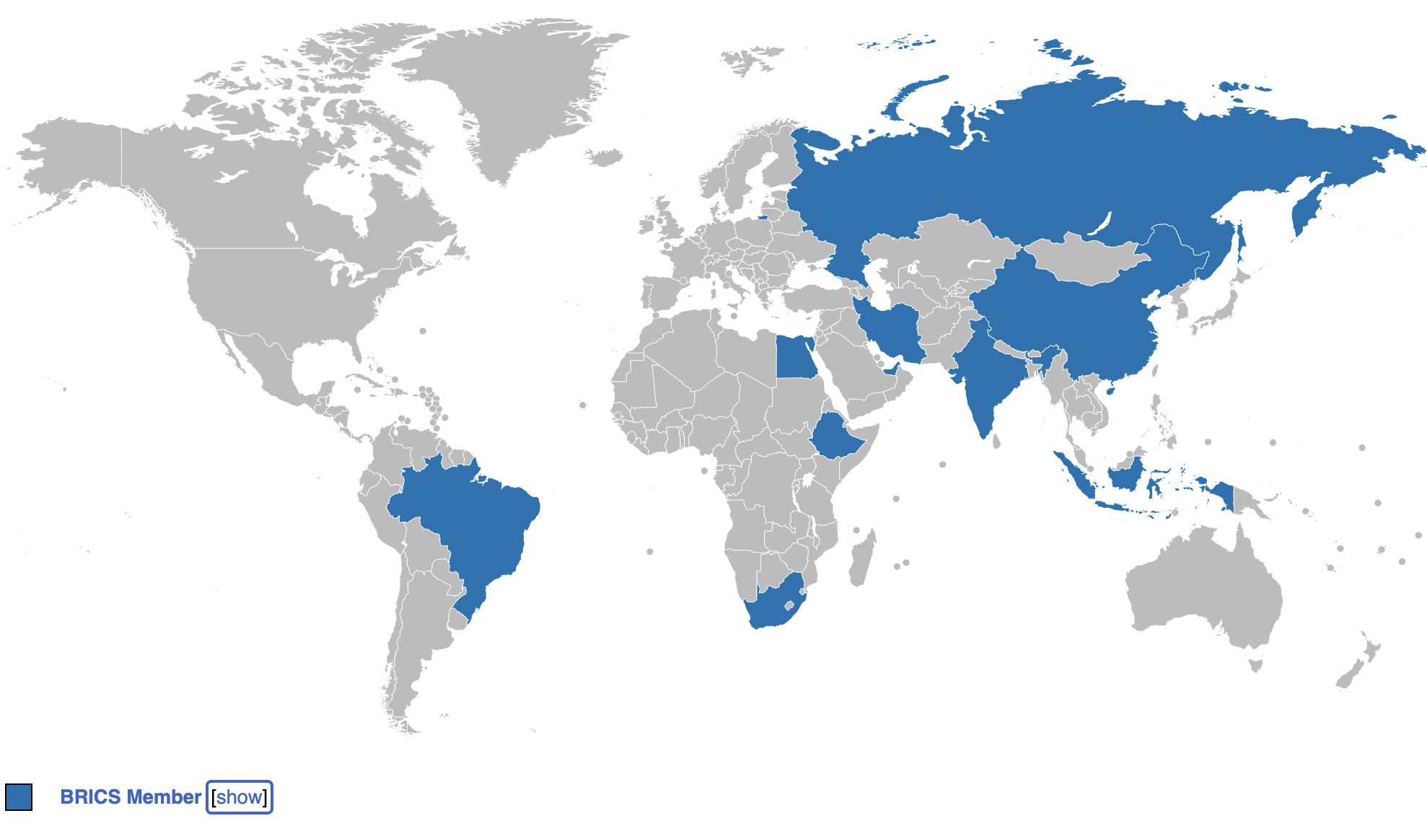
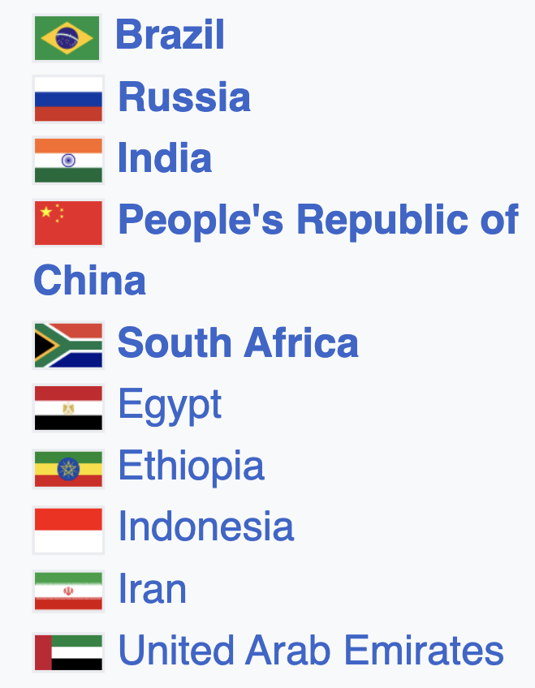
BRICS member Countries
Notes:
BRICS expanded from five to ten countries in 2024, now comprising Brazil, Russia, India, China, South Africa, plus Egypt, Ethiopia, Indonesia, Iran, and the United Arab Emirates.
The map shows a presence on four continents, spanning every major time zone.
Together we account for 45% of the world’s population and almost one-third of global GDP (PPP).
Our diversity is strategic: oil and gas in the Gulf and Russia, biofuels in Brazil, tech hubs in China and India, and critical minerals across Africa.
This reach provides the critical mass for science and innovation, but it also demands well-structured coordination—the focus of the next slides.

Slide 3
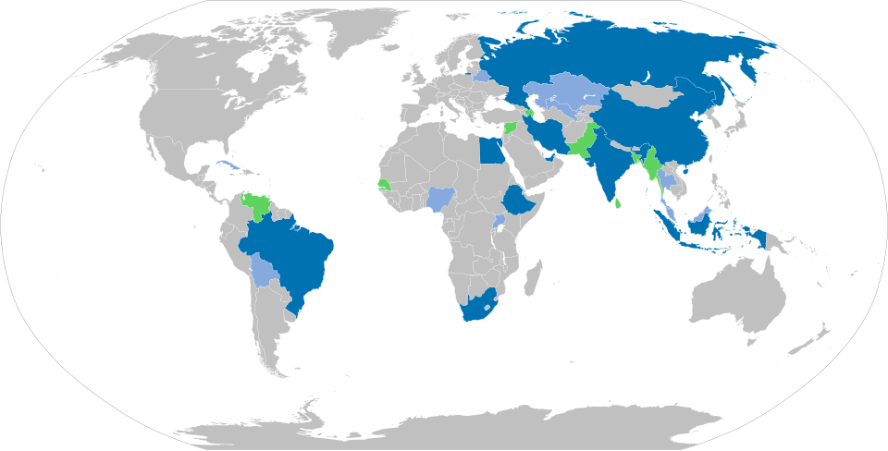
Notes:
What the map shows
Dark blue: the ten full BRICS members we just discussed.
Light blue: nine recognized partners—Belarus, Bolivia, Cuba, Kazakhstan, Malaysia, Nigeria, Thailand, Uganda, and Uzbekistan.
Why the partners matter
They participate in BRICS working groups and ministerial meetings, giving the bloc a wider diplomatic and economic reach.

Slide 4
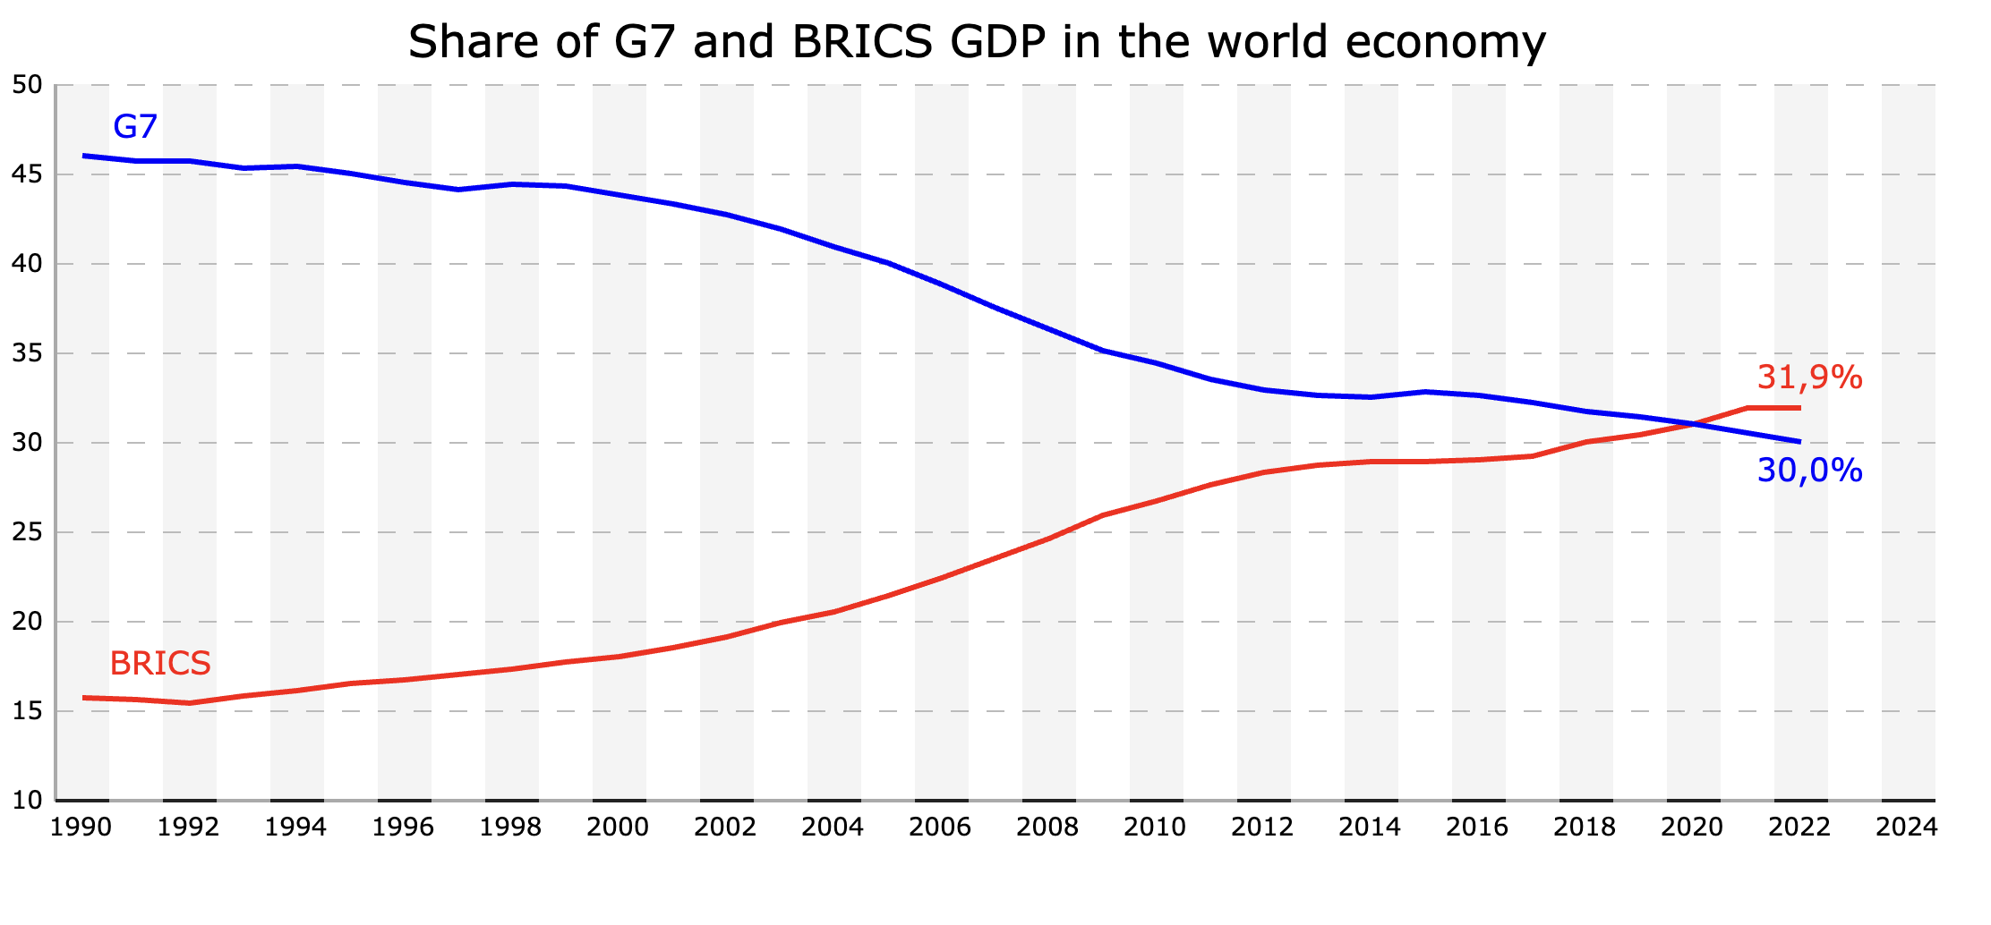
Source: https://en.wikipedia.org/wiki/BRICS#/media/File:GDP_BRICS_G7.svg
G7 vs BRICS: Economy and Knowledge Production
Source: SciVal, data exported 20 Jun 2025
Notes:
Economic shift. In 1990 the G7 controlled nearly half of global GDP while BRICS held about 13%. Over three decades the gap closed: by 2022 BRICS reach 31.9%, edging past the G7 at 30.0%.
Scientific crossover. The scholarly-output curve is even sharper. G7 share fell from roughly 60% in the late 1990s to 34.7% today, while BRICS climbed from about 8% to 41.0%, overtaking around 2022.
Key takeaway. The center of gravity for both economic power and scientific production is tilting toward BRICS—creating fresh opportunities for collaboration and prompting a rethink of global research governance.

Slide 5
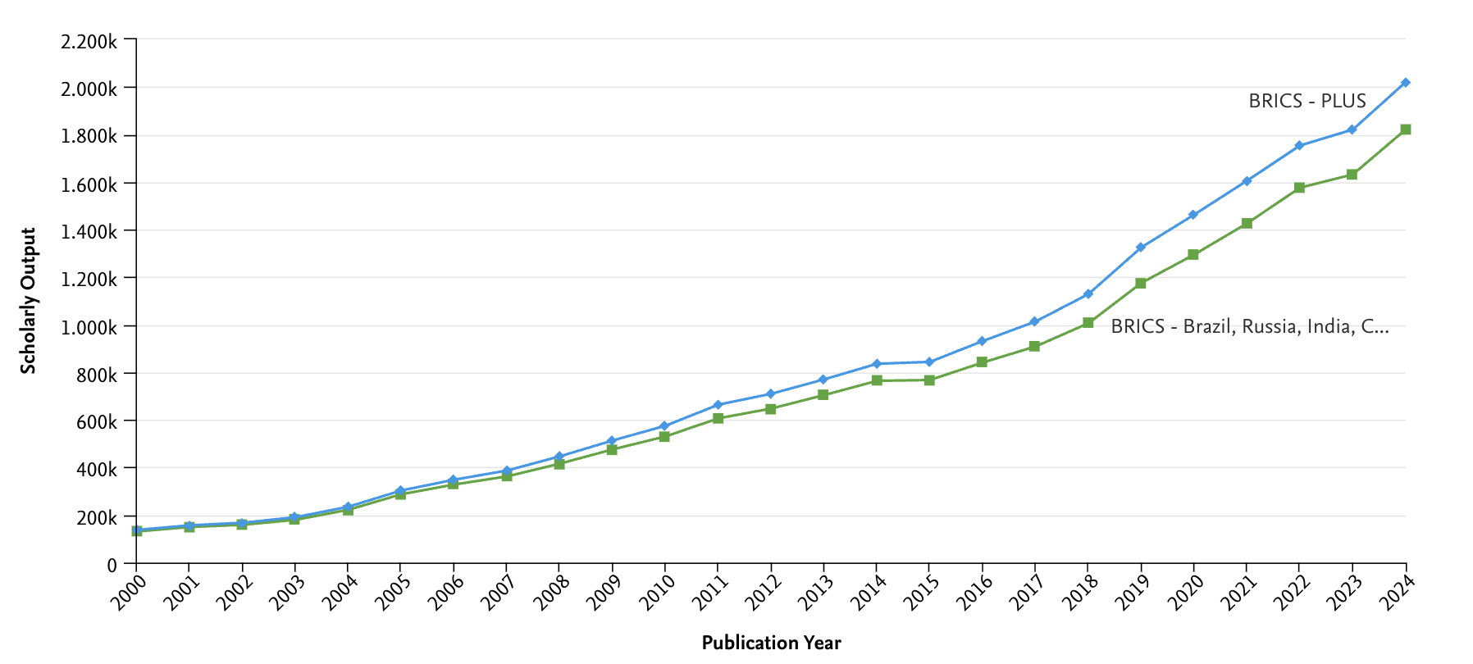
Scholarly Output Trajectory of BRICS and BRICS-Plus Nations (2000 – 2024)
Source: SciVal, Elsevier. Data exported 20 Jun 2025 (Scopus coverage 2000–2024)
Notes:
Steady climb for both curves. From about 160 k papers in 2000, core BRICS reach nearly 1.8 M in 2024—a 12-fold rise.
Acceleration after expansion. The blue BRICS-Plus line pulls ahead around 2017; by 2024 it tops 2.0 M papers, roughly 15% above the core group.
Why the gap widens. New members—Indonesia, Egypt, Iran, UAE, Ethiopia—bring fast-growing university systems and strong government R&D drives, adding volume and fresh collaboration links.
Inflection points. Notice the plateau in 2014-2015 (global funding squeeze) and the sharper slope post-2018 (pandemic-related research surge plus digital collaboration tools).
Key takeaway. Expansion is more than political symbolism; it tangibly boosts the bloc’s knowledge output and signals rising scientific influence on the world stage.

Slide 6
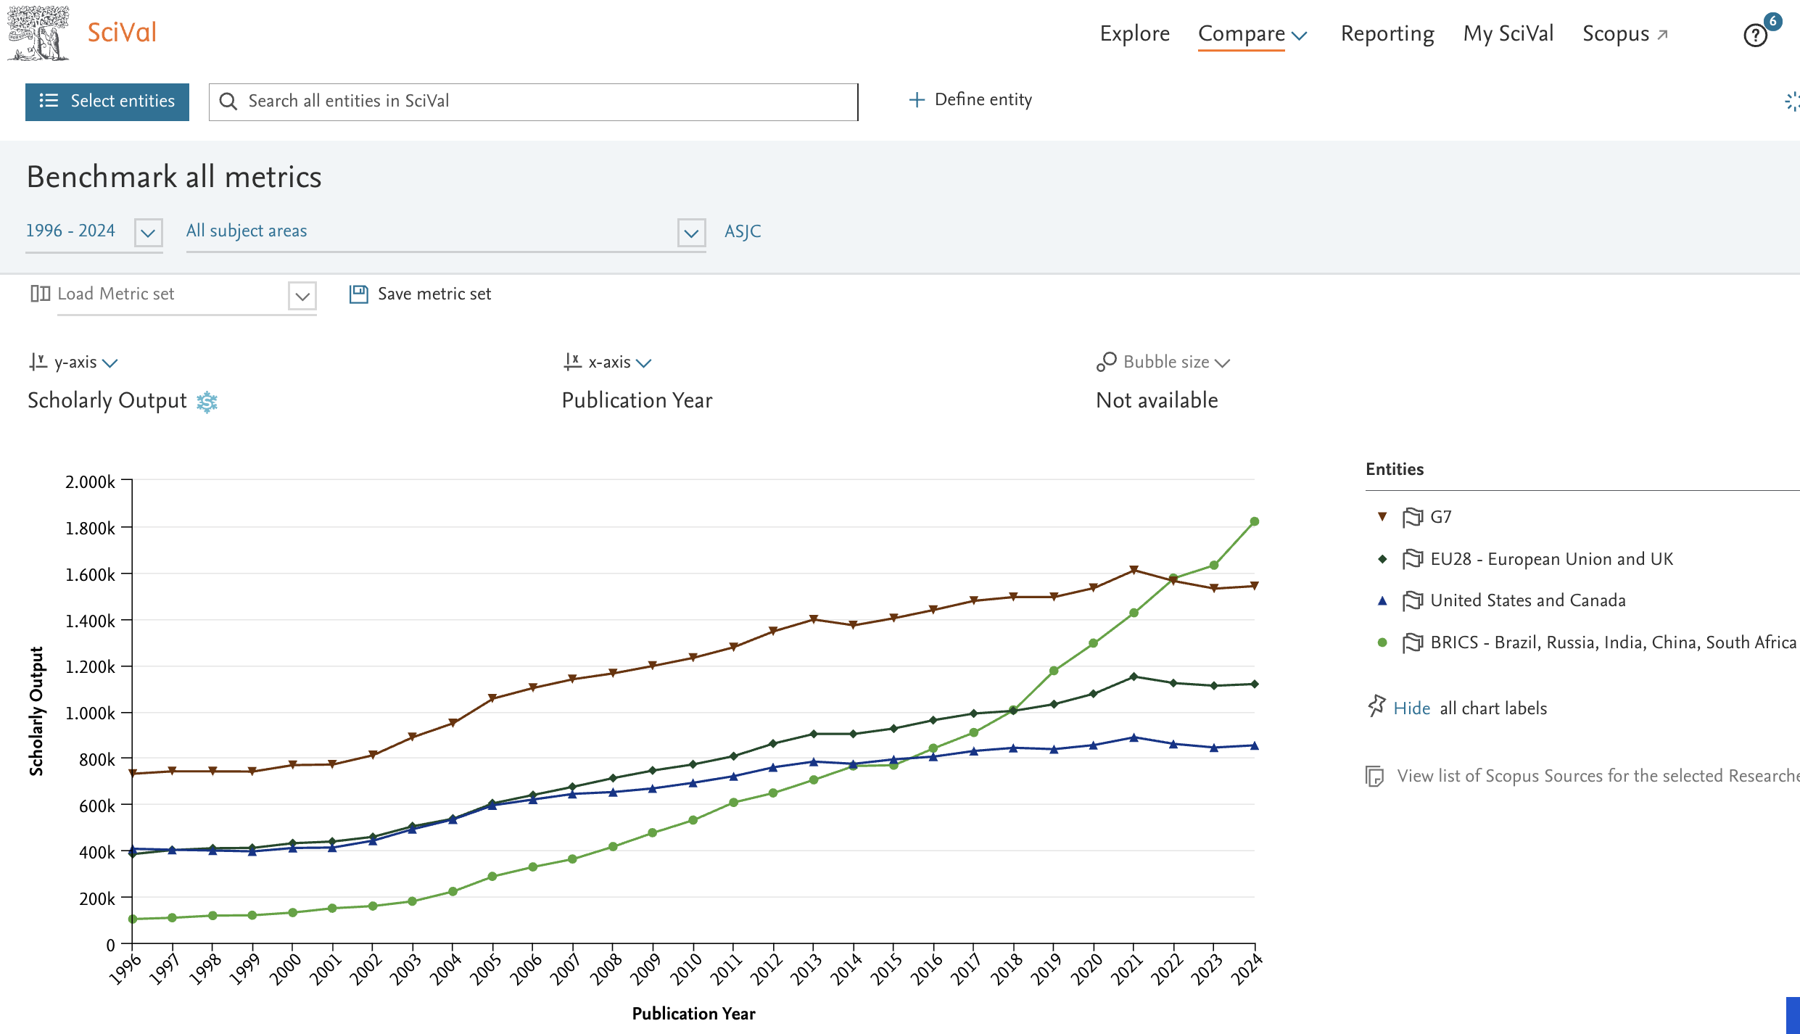
Source: SciVal, Elsevier. Data exported 20 Jun 2025 (Scopus coverage 1996–2024)
Notes:
Lines: BRICS (green), EU-28 + UK (brown), US + Canada (blue), G7 (black).
Cross-overs: BRICS outpaces North America in 2017, overtakes the EU + UK in 2019, and surpasses the G7 in 2022; by 2024 it leads the G7 by roughly 200 k publications.
Drivers: Rapid expansion of universities and strong R&D policies in China and India, contrasted with flatter funding growth in Europe and North America.
Bottom line: BRICS now tops every major bloc in scholarly output, signaling a lasting shift in the global research landscape.

Slide 7
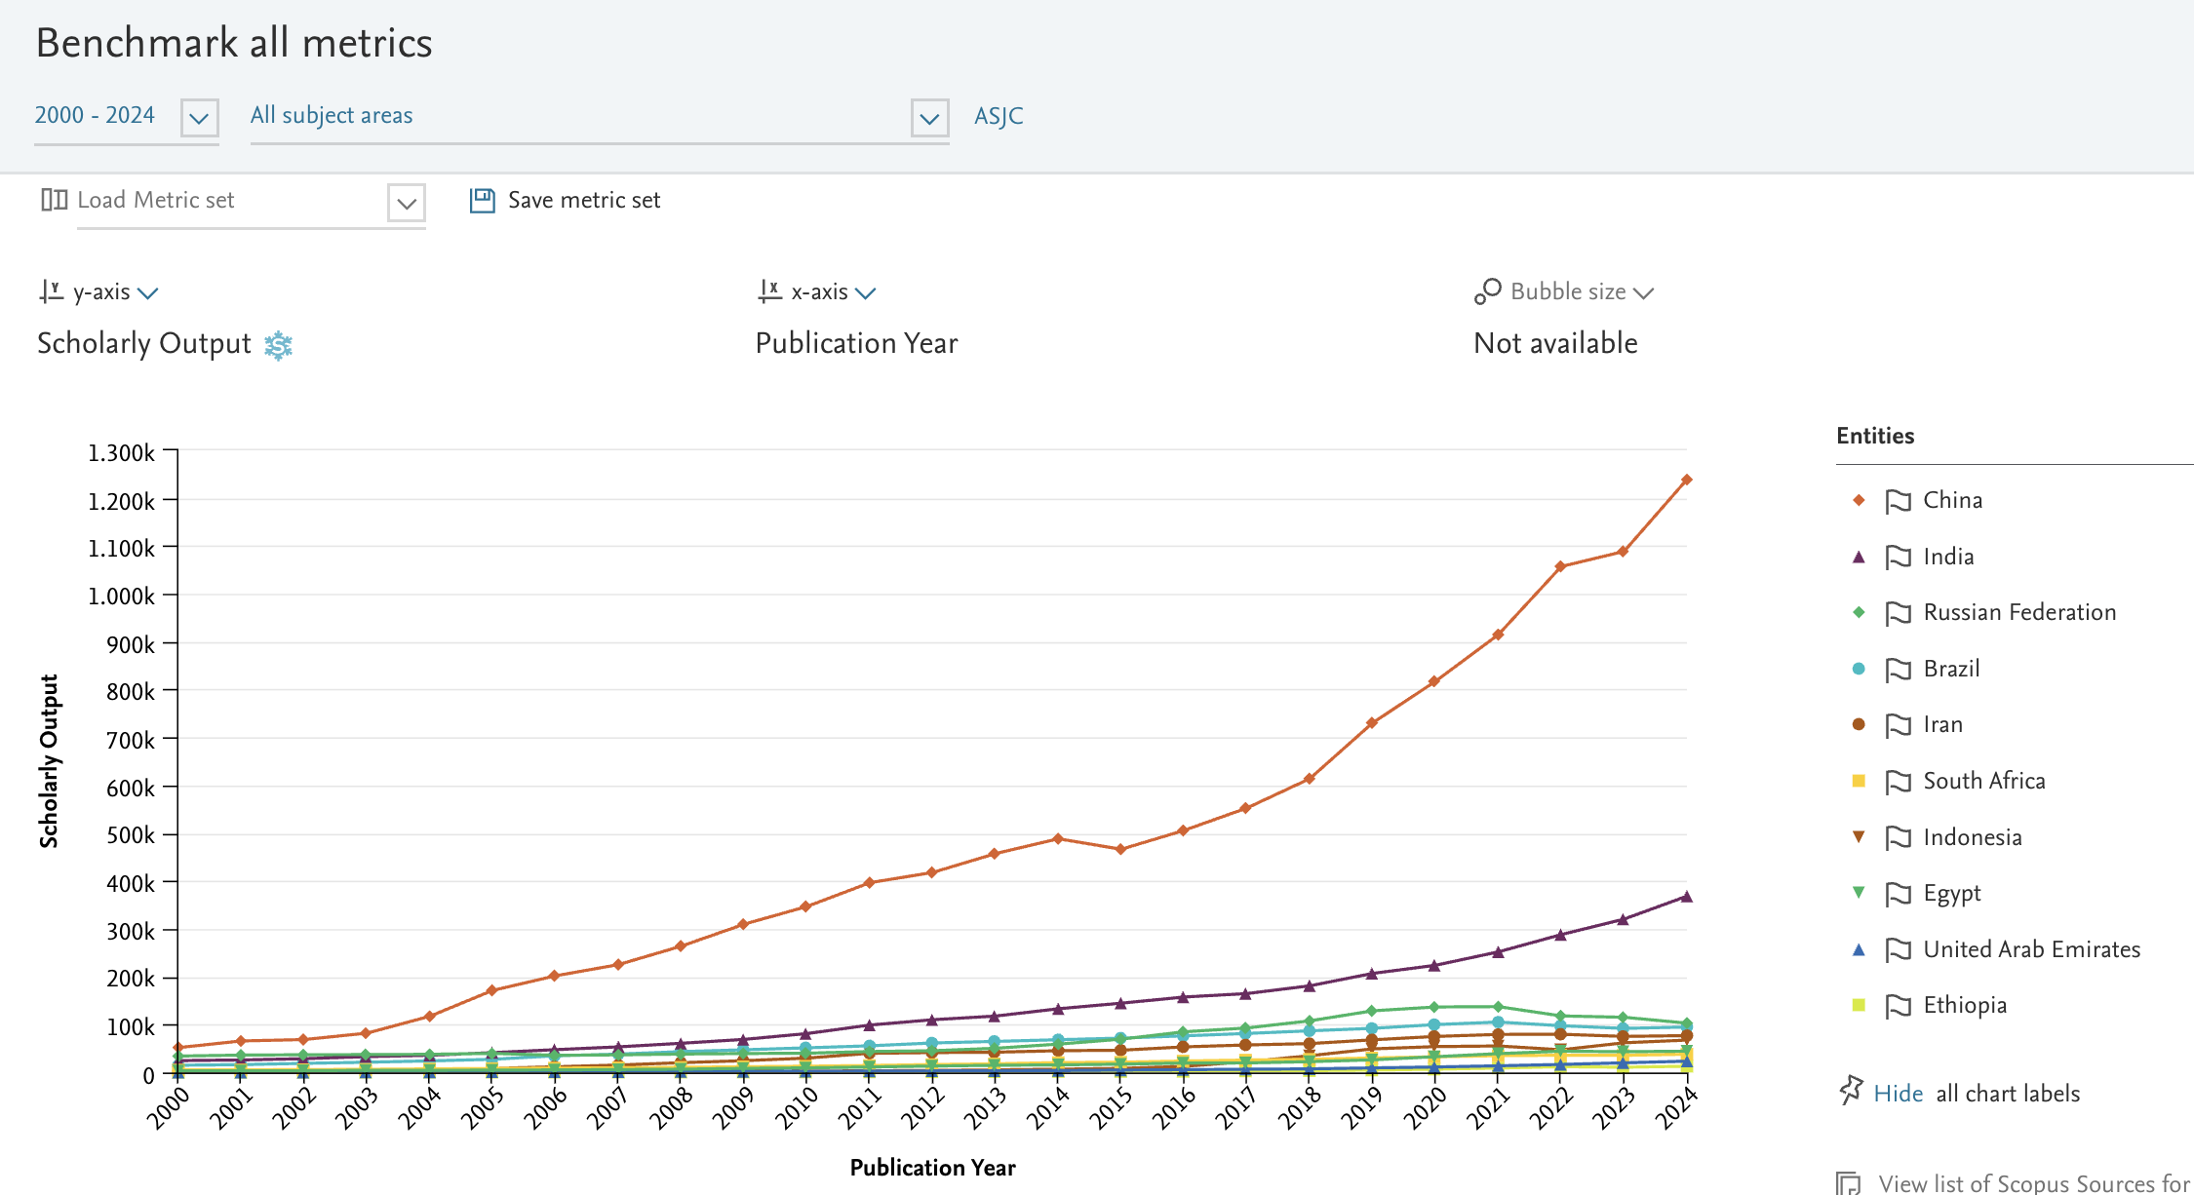
Source: SciVal, Elsevier. Data exported 20 Jun 2025 (Scopus coverage 2000–2024)
Notes:
China (orange line). The clear powerhouse—output grows from ~60 k papers in 2000 to >1.2 M in 2024, a twenty-fold increase that now represents roughly two-thirds of all BRICS-Plus publications.
India (purple). Steady second mover—rises from ~20 k to >350 k, quadrupling since 2010 and closing the gap with many G7 members.
Russia & Brazil (green and teal). Both hover around 35–120 k papers. Russia grows more slowly after 2014; Brazil peaks near 110 k in 2021 before a slight dip.
South Africa & Iran (yellow square, brown circle). Maintain moderate, consistent growth, each reaching ~40 k papers by 2024.
Newer members—Indonesia, Egypt, UAE, Ethiopia (orange triangle, light green, blue, light yellow). Still small in absolute terms (<25 k each) but post double-digit annual growth, signaling fresh capacity.
Key takeaway. China and India drive the bloc’s surge, but the long tail of smaller members is beginning to accelerate, adding diversity and new collaboration opportunities across the BRICS-Plus network.

Slide 8
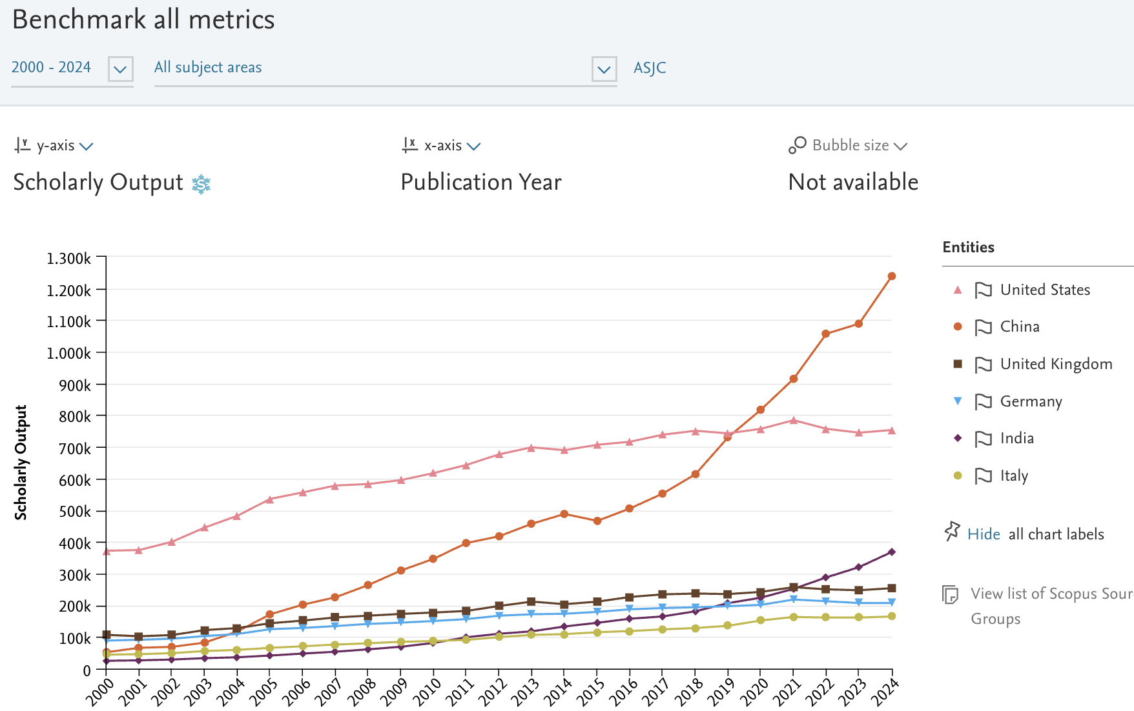
Source: SciVal, Elsevier. Data exported 20 Jun 2025 (Scopus coverage 2000–2024)
Notes:
China (orange circles) Surges from ≈80 k papers in 2000 to >1.25 M in 2024.
Overtakes the United States in 2019 and now publishes about 60 % more than the USA.
Growth reflects massive R&D investment, expanded PhD training, and strong incentives to publish internationally.
United States (pink triangles) Climbs steadily to ≈780 k papers in 2016, then plateaus and edges down slightly, ending 2024 near 750 k.
Still a scientific powerhouse, but its share of global output is shrinking as others scale up.
India (purple diamonds) Fastest riser after China—jumps from <25 k to ≈370 k papers, a 15-fold increase.
Passes Germany in 2020 and the UK in 2023, now ranks third worldwide.
United Kingdom (brown squares) & Germany (blue triangles)
Moderate growth from ≈90 k to 240–260 k papers.
Both show slight tapering after 2020, mirroring tighter R&D budgets and demographic limits.
Italy (yellow circles) Moves from ≈40 k to about 130 k papers—steady but slower than the other European peers.
Key takeaway The global centre of scientific output is shifting decisively toward Asia, with China and India driving the trend.
Traditional leaders remain influential, yet their relative weight is declining, underscoring a more multipolar research landscape.

Slide 9
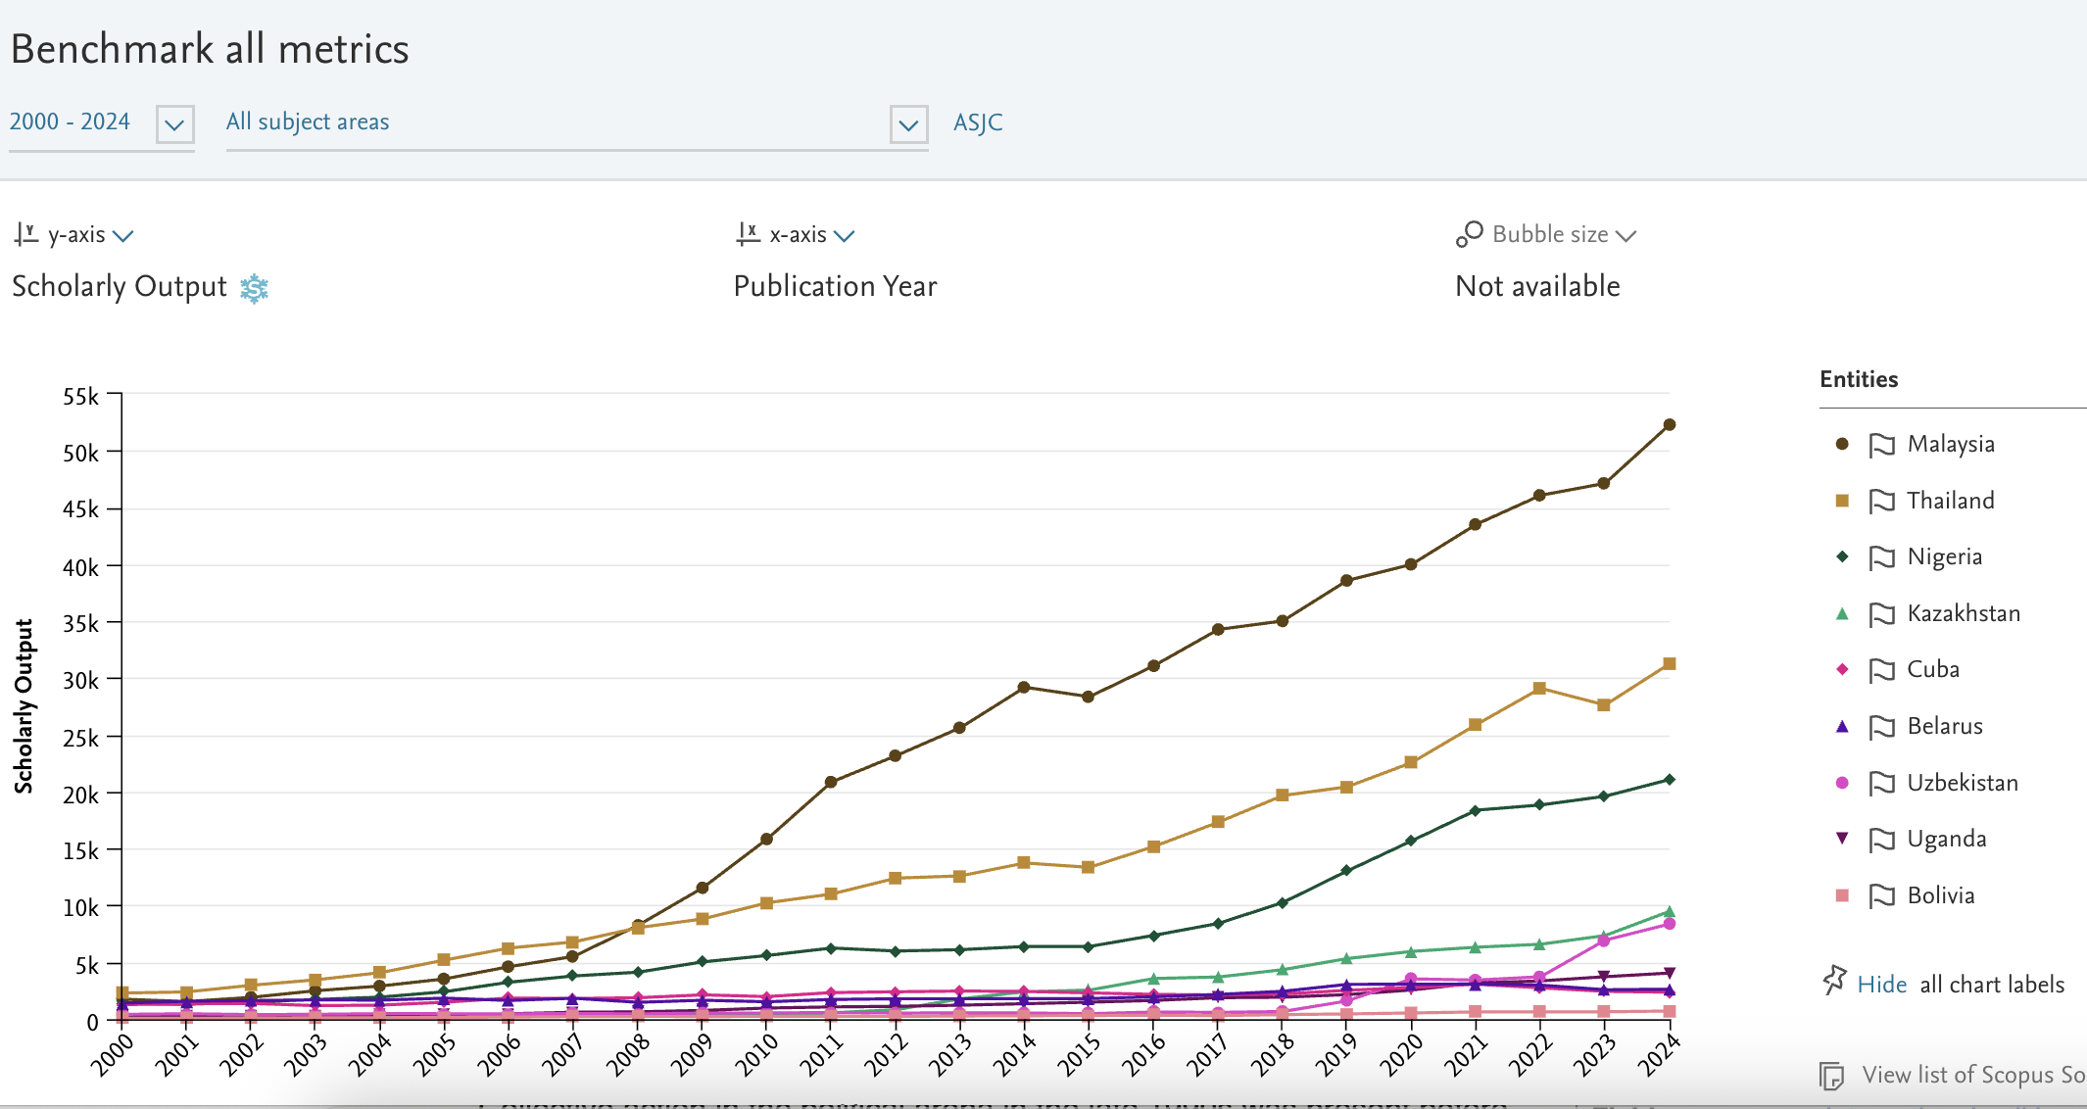
Source: SciVal, Elsevier. Data exported 20 Jun 2025 (Scopus coverage 2000–2024)
Notes:
Emerging Partners’ Scholarly Output (2000-2024)” ≈ 45 s
Malaysia (dark circle) sits at the top—steady climb, passing 50 k papers in 2024. Long-term electronics and biotech policies are paying off.
Thailand (gold square) is a close second, topping 30 k papers. Growth accelerates after 2016 alongside major R&D tax incentives.
Nigeria (green diamond) is the breakout story: output triples in seven years, reaching 20 k. Rapid university expansion and health-science funding drive the curve.
Kazakhstan (teal triangle) moves past 10 k papers, fueled by mineral-processing and space-science research at Baikonur.
Cuba, Belarus, Uzbekistan, Uganda, Bolivia (lower curves) stay below 6 k each but show consistent upward trends—evidence that “small but steady” partners are joining the knowledge economy.
Take-home: While China and India supply volume, this second tier adds geographic reach and subject diversity, strengthening the BRICS-Plus research network from Southeast Asia to West Africa and Central Asia.

Slide 10
Global Shift in Scholarly Output – Regional Shares, 2000 - 2024
Region | 2000 | 2002 | 2004 | 2006 | 2008 | 2010 | 2012 | 2014 | 2016 | 2018 | 2020 | 2022 | 2024
Asiatic Region | 17,8% | 18,8% | 20,4% | 23,0% | 24,4% | 26,1% | 28,4% | 28,4% | 27,9% | 29,8% | 32,7% | 36,1% | 38,9%
Western Europe | 35,2% | 34,1% | 33,2% | 32,4% | 32,0% | 30,9% | 29,5% | 29,5% | 29,4% | 27,9% | 26,1% | 24,9% | 23,5%
Northern America | 31,5% | 30,9% | 30,4% | 28,6% | 26,4% | 25,3% | 22,7% | 22,7% | 21,8% | 20,6% | 18,1% | 16,4% | 15,4%
Middle East | 2,1% | 2,4% | 2,7% | 2,8% | 3,2% | 3,6% | 4,1% | 4,1% | 4,5% | 4,6% | 5,3% | 5,8% | 6,3%
Eastern Europe | 6,6% | 6,7% | 6,2% | 5,6% | 5,8% | 5,6% | 6,0% | 6,0% | 6,6% | 7,0% | 7,3% | 6,4% | 5,8%
Latin America | 2,7% | 3,0% | 3,0% | 3,3% | 3,6% | 3,6% | 3,9% | 3,9% | 4,1% | 4,3% | 4,5% | 4,1% | 3,9%
Africa | 1,3% | 1,3% | 1,4% | 1,5% | 1,6% | 1,8% | 2,3% | 2,3% | 2,5% | 2,7% | 3,1% | 3,5% | 3,6%
Pacific Region | 2,8% | 2,8% | 2,8% | 2,9% | 3,0% | 3,0% | 3,2% | 3,2% | 3,3% | 3,1% | 2,9% | 2,8% | 2,6%
Source: SciVal, Elsevier. Data exported 20 Jun 2025 (Scopus coverage 2000–2024)
Notes:
Asiatic Region – Exhibits the most pronounced growth, expanding its share from 17.8 % to 38.9 %; now constitutes the largest contributor to global scholarly output.
Western Europe – Records a gradual decline from 35.2 % to 23.5 %, yet remains a leading hub of research activity.
Northern America – Declines markedly from 31.5 % to 15.4 %, reflecting increased global competition and redistribution of research capacity.
Middle East – Triples its contribution, rising from 2.1 % to 6.3 %, driven by sustained investment in research and development.
Eastern Europe – Maintains a relatively stable range (5–7 %), ending at 5.8 %; indicates consistent output amid structural challenges.
Latin America – Advances modestly from 2.7 % to 3.6 %, with recent stagnation highlighting the need for stronger research support mechanisms.
Africa – Grows from 1.3 % to 3.6 %, representing one of the highest proportional increases, though from a low initial base.

Slide 11
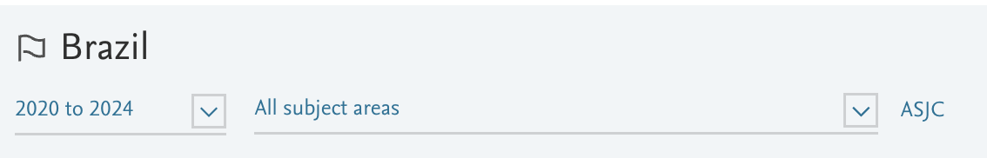
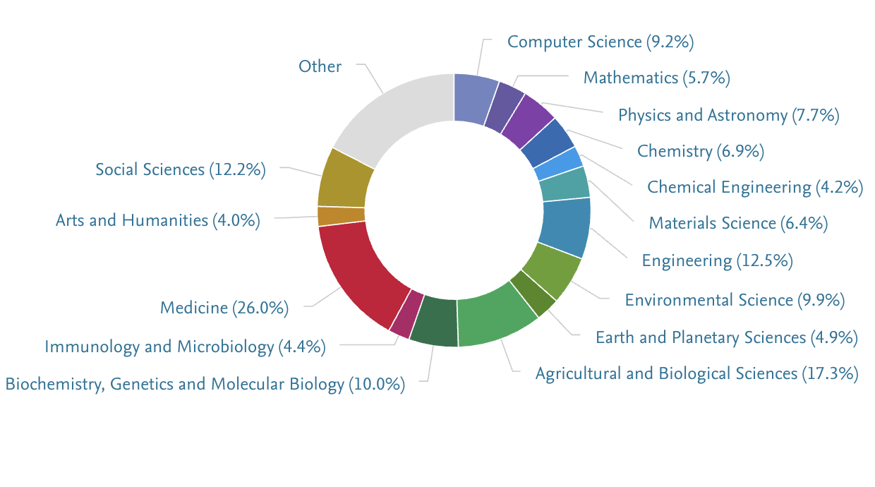
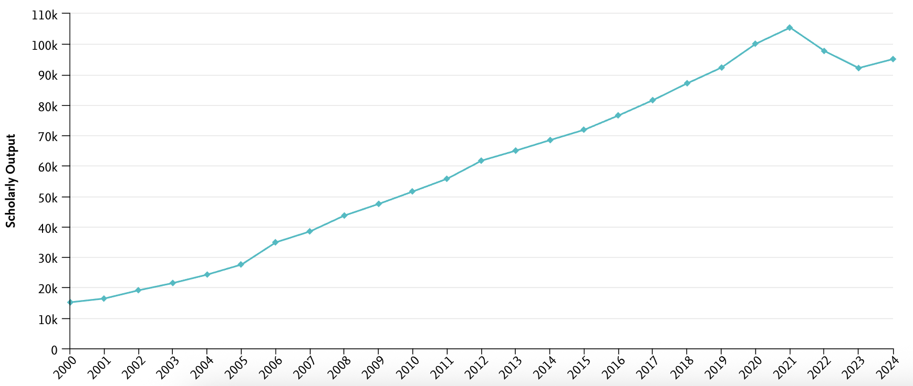
Source: SciVal, Elsevier. Data exported 20 Jun 2025 (Scopus coverage 2020–2024)
Notes:
“Brazilian Research Portfolio (2020-2024)”
Life-science dominance.
Medicine leads with 26 % of total publications. Agricultural & Biological Sciences add another 17.3 %, and Genetics & Molecular Biology 10 %—reflecting Brazil’s historic strengths in public health, tropical medicine, and agri-innovation.
Engineering & technology backbone.
Combined Engineering (12.5 %) and Computer Science (9.2 %) signal an expanding tech sector. Add Materials (6.4 %) and Chemical Engineering (4.2 %) and nearly one-third of output serves industrial and digital transformation needs.
Environmental focus.
Environmental Science accounts for 9.9 %, underscoring Brazil’s role in sustainability and Amazon-related research. Earth & Planetary Sciences contribute another 4.9 %.
Balanced social contribution.
Social Sciences deliver 12.2 %—a sizable share compared with many peer nations—while Arts & Humanities hold 4 %, supporting broader societal engagement.
Growth trajectory.
The inset line chart shows a steady climb in overall publication volume through 2023, with only a mild dip in 2024—likely reflecting post-pandemic funding adjustments.
Key takeaway.
Brazil fields a diverse yet life-science-heavy research portfolio, complemented by solid engineering and environmental programs—positioning the country to tackle health, food-security, and sustainability challenges while advancing its digital economy.

Slide 12
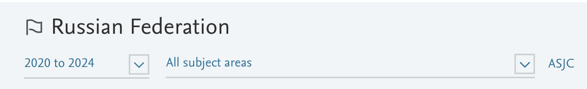
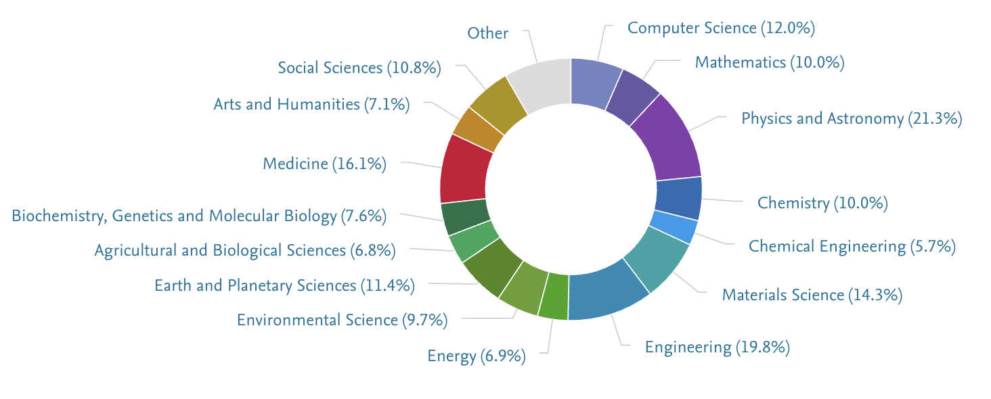
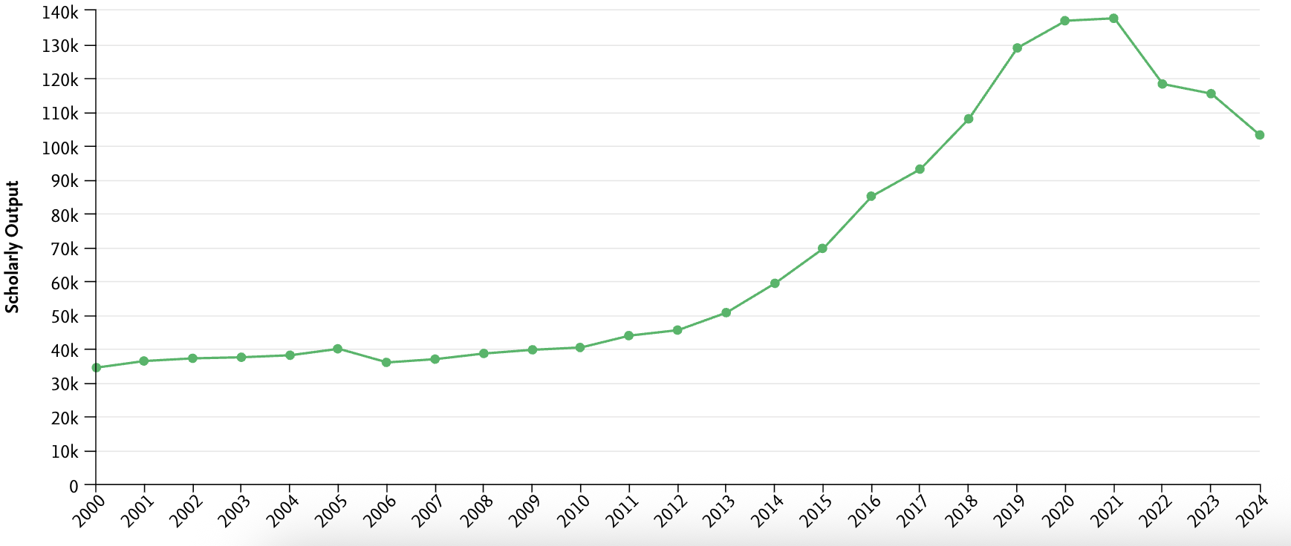
Source: SciVal, Elsevier. Data exported 20 Jun 2025 (Scopus coverage 2020–2024)
Notes:
Russian Portfolio (2020-24)
Physical-science heavy: Physics & Astronomy (21%), Engineering (20%) and Materials Science (14%) dominate—mirroring Russia’s space, nuclear and advanced-manufacturing priorities.
Digital & chemical anchors: Computer Science (12%) plus Mathematics and Chemistry (~10% each) support modelling, cybersecurity and high-tech processes.
Health & life sciences: Medicine (16%) and Biochemistry/Genetics (8%) form a solid biomedical layer.
Planet & environment: Earth & Planetary Sciences (11%) and Environmental Science (10%) back Arctic, climate and resource studies; Energy research sits at 7%.
Balanced social input: Social Sciences (11%) and Arts & Humanities (7%) keep policy and cultural angles in view.
Key takeaway.
Russia’s portfolio skews toward physics, engineering, and computational disciplines, complemented by solid medical and environmental programs—positioning the country for space exploration, advanced materials, and energy innovation while maintaining a diverse scientific base.

Slide 13
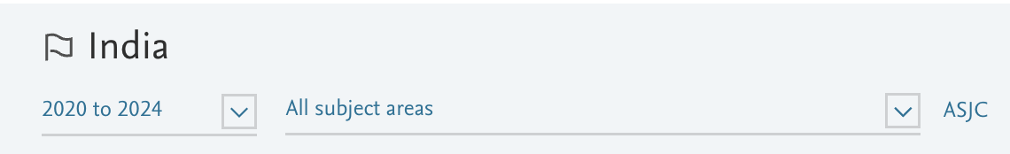
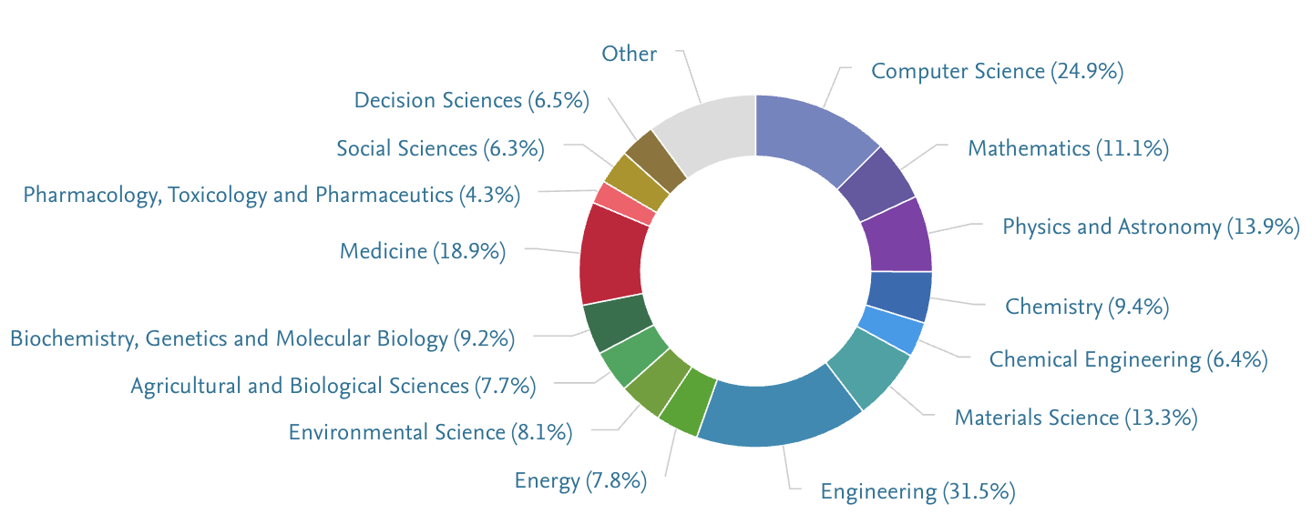
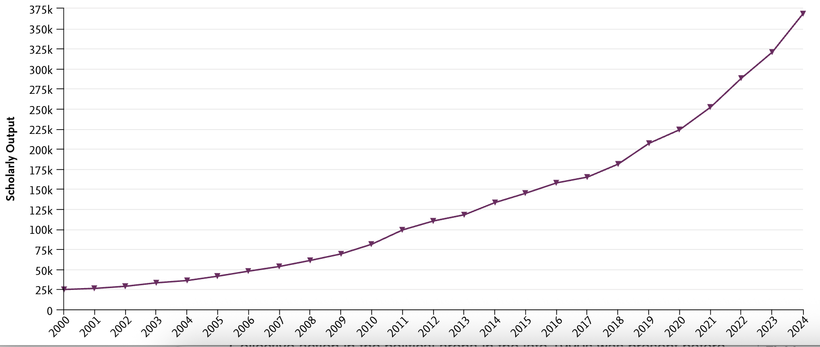
Source: SciVal, Elsevier. Data exported 20 Jun 2025 (Scopus coverage 2020–2024)
Notes:
Indian Portfolio (2020-24)
Tech-centric profile: Engineering leads with 31.5%, followed by Computer Science at 24.9%—underlining India’s push for digital infrastructure, semiconductors, and start-up innovation.
Strong fundamentals: Physics & Astronomy (13.9%), Materials Science (13.3%), and Mathematics (11.1%) show depth in core STEM areas that feed high-tech industries.
Health sciences: Medicine contributes 18.9%, while Biochemistry / Genetics add 9.2% and Pharma-related fields 4.3%, reflecting India’s role in vaccines and generics.
Sustainability angle: Environmental Science (8.1%) and Energy (7.8%) support national goals for green growth and climate resilience.
Social & decision research: Social Sciences (6.3%) and Decision Sciences (6.5%) provide insights for policy, management, and data-driven governance.
Trend: Inset chart shows an uninterrupted, steep climb—roughly tripling total publications since 2010—signaling accelerating research capacity and global influence.

Slide 14
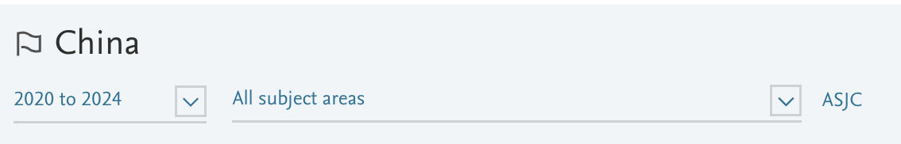
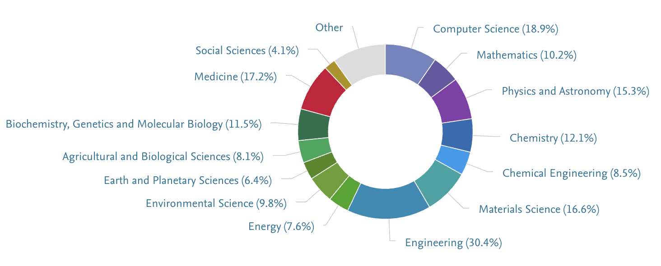
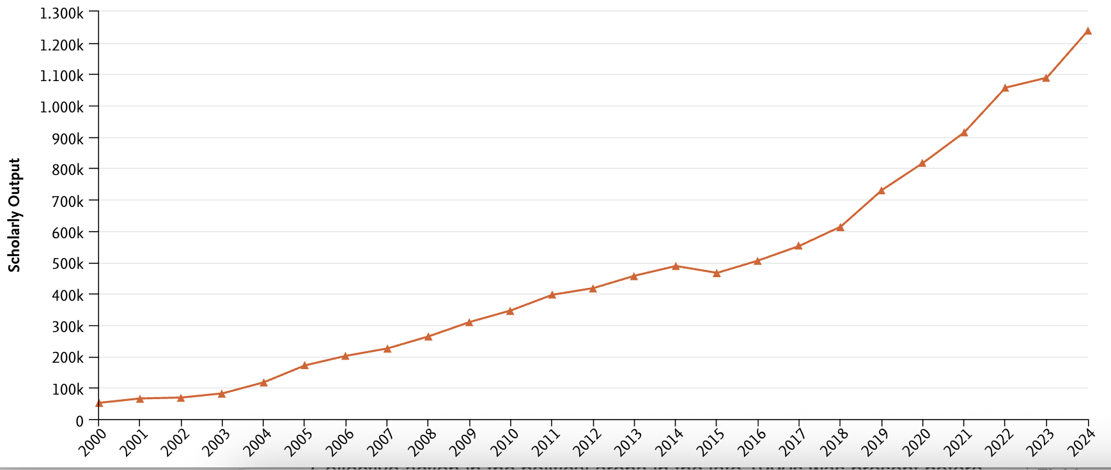
Source: SciVal, Elsevier. Data exported 20 Jun 2025 (Scopus coverage 2020–2024)
Notes:
Chinese Portfolio (2020-24)
Engineering powerhouse: Engineering leads with 30.4%, underpinned by massive infrastructure, aerospace, and manufacturing programs.
Digital & data stack: Computer Science (18.9%) and Mathematics (10.2%) fuel AI, big-data, and fintech expansion.
Core STEM depth: Physics & Astronomy (15.3%), Materials Science (16.6%), and Chemistry (12.1%) provide the scientific backbone for high-tech industries.
Life-science scale: Medicine (17.2%) and Biochemistry/Genetics (11.5%) reflect huge investments in biotech, vaccines, and precision health.
Green agenda: Environmental Science (9.8%), Energy research (7.6%), and Agri-Biological Sciences (8.1%) support carbon-neutral and food-security goals.
Trend: Inset chart shows an unbroken, steep climb—China now produces over 1.2 million papers a year, leading global output and driving BRICS-Plus growth.

Slide 15
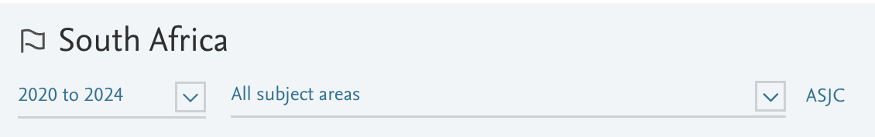
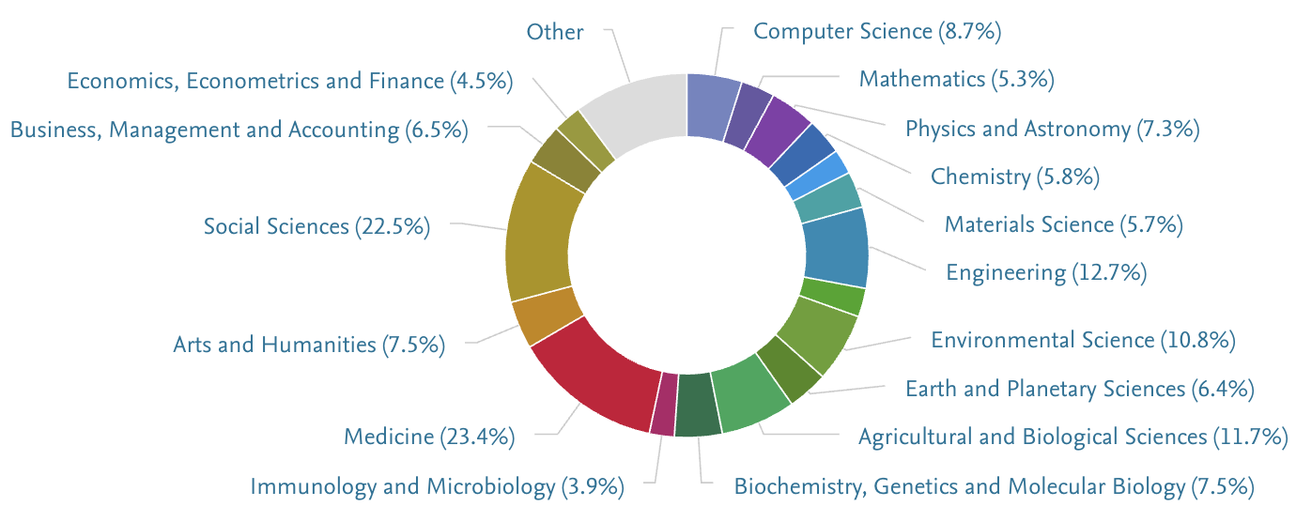
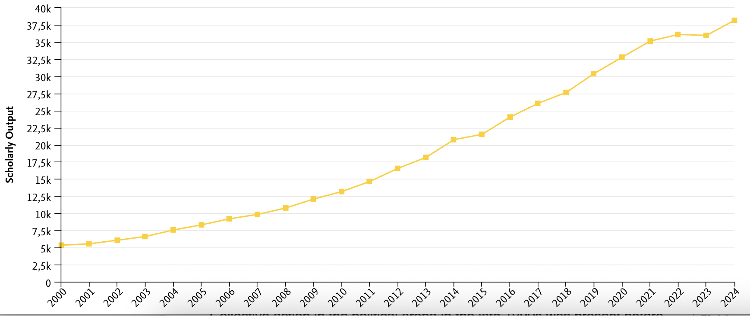
Source: SciVal, Elsevier. Data exported 20 Jun 2025 (Scopus coverage 2020–2024)
Notes:
South African Portfolio (2020-24)
Health & society lead: Medicine accounts for 23.4% of publications and Social Sciences 22.5%, reflecting South Africa’s global-health focus and social-transformation agenda.
Agri-bioscience & environment: Agricultural/Biological Sciences contribute 11.7% and Environmental Science 10.8%, aligning with food security and climate-adaptation priorities.
Engineering & tech backbone: Engineering stands at 12.7%, Computer Science 8.7%, and Materials Science 5.7%, supporting infrastructure, mining, and digital innovation.
STEM fundamentals: Physics & Astronomy (7.3%) and Mathematics (5.3%) bolster advanced research capacity.
Business & economics: Business/Management (6.5%) and Economics/Finance (4.5%) provide insights for policy and growth strategies.
Trend: The inset shows steady, uninterrupted growth—more than doubling output since 2010—highlighting expanding research capacity and diversified strengths.

Slide 16
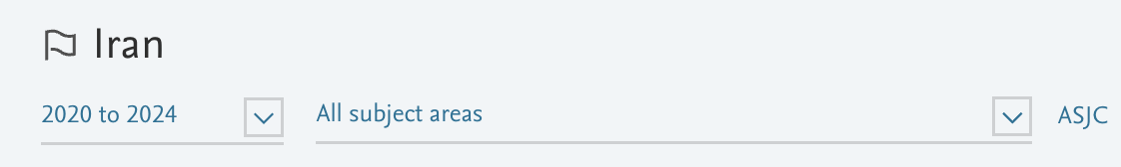
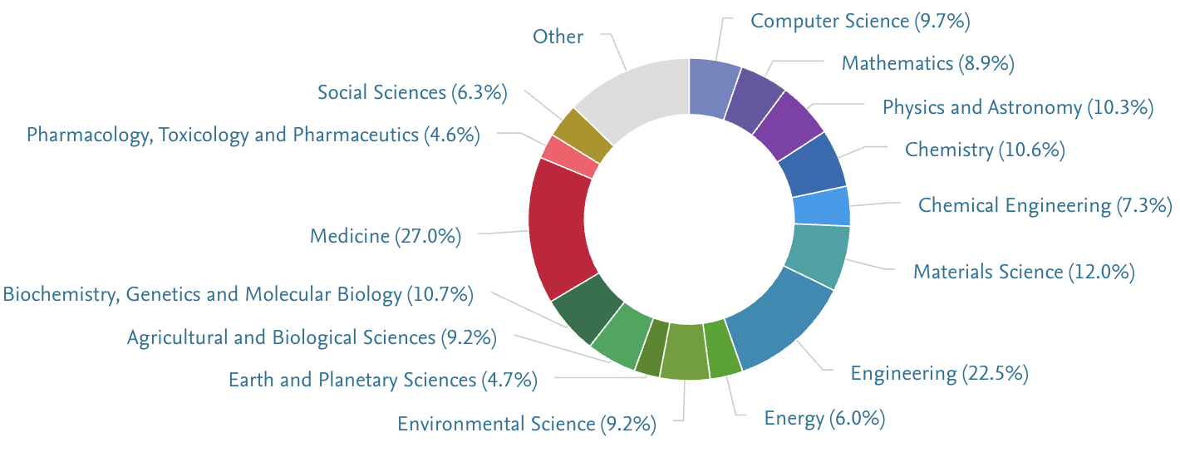
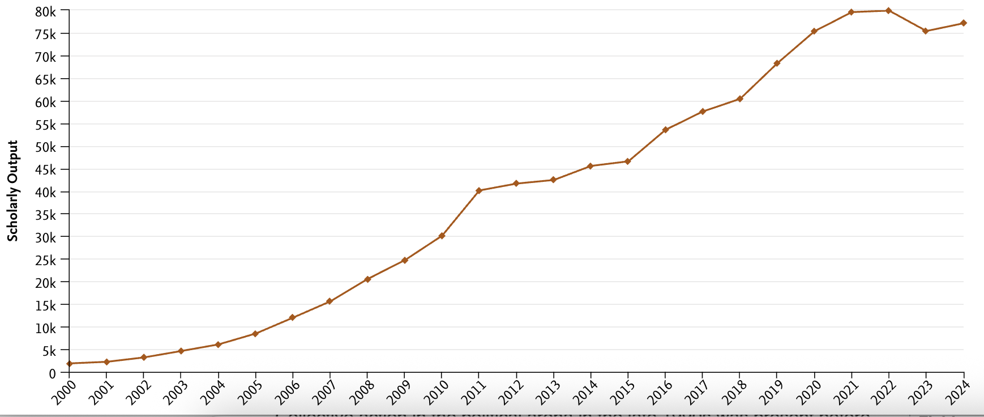
Source: SciVal, Elsevier. Data exported 20 Jun 2025 (Scopus coverage 2020–2024)
Notes:
Iranian Portfolio (2020-24)
Two pillars: Medicine leads with 27% of publications, while Engineering contributes 22.5%—together almost half of Iran’s output.
Strong applied STEM: Materials Science 12%, Chemistry 10.6%, Physics & Astronomy 10.3%, and Chemical Engineering 7.3% support advances in energy, nanotech, and defense.
Computing & maths base: Computer Science 9.7% and Mathematics 8.9% underpin data analytics, AI, and modelling.
Life-science depth: Biochemistry/Genetics 10.7% and Agri-Biological Sciences 9.2% align with pharma, food security, and biotech goals.
Environmental & energy focus: Environmental Science 9.2% and Energy research 6.0% target sustainability and resource management.
Trend: Output grew rapidly to 2022, then levelled off—suggesting funding constraints but a still-expanding knowledge base across health, engineering, and applied sciences.

Slide 17
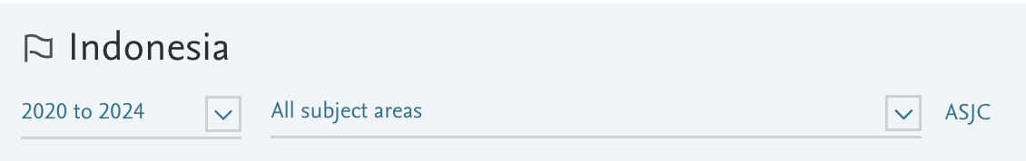
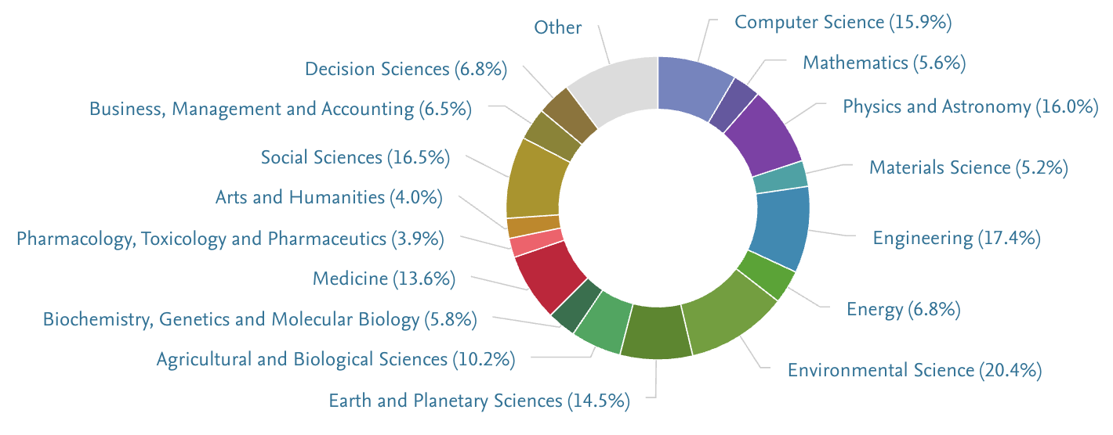
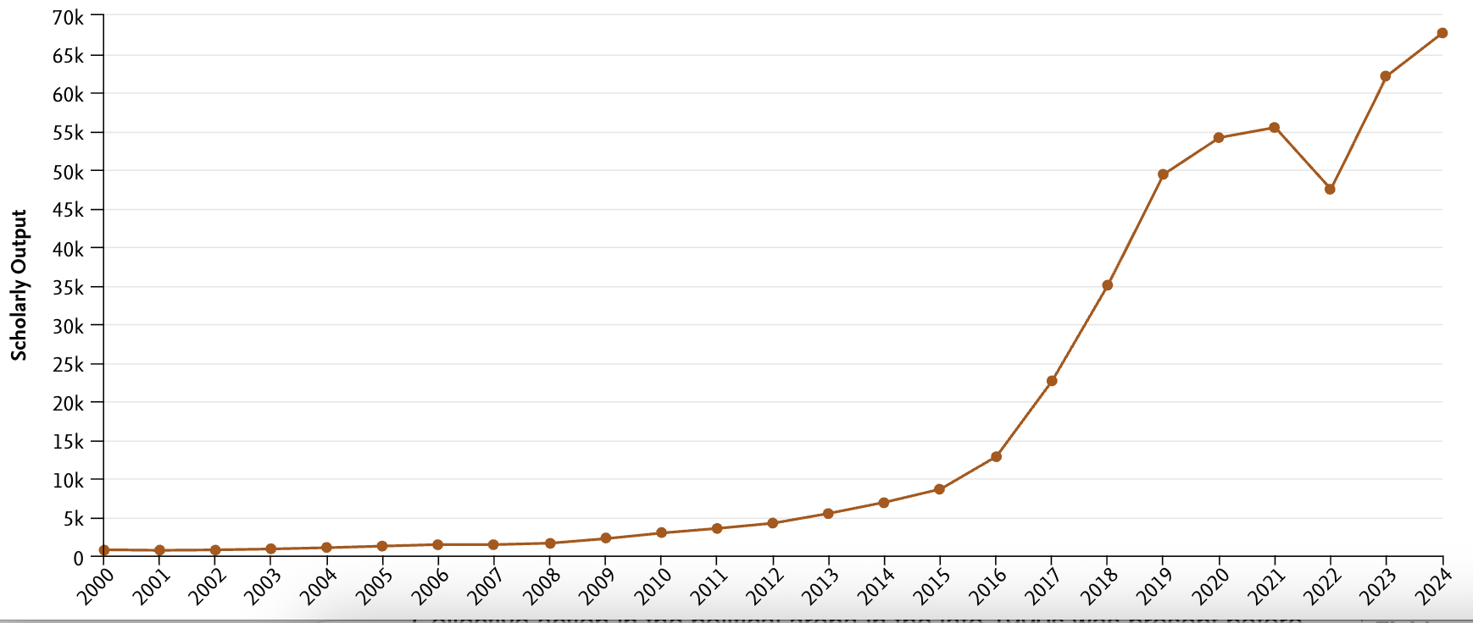
Source: SciVal, Elsevier. Data exported 20 Jun 2025 (Scopus coverage 2020–2024)
Notes:
Indonesian Portfolio (2020-24)
Environmental & Earth focus: Environmental Science tops the chart at 20.4%, with Earth & Planetary Sciences adding 14.5%—mirroring Indonesia’s priorities in climate resilience, marine ecosystems, and disaster risk.
STEM surge: Engineering (17.4%), Physics & Astronomy (16.0%), and Computer Science (15.9%) show rapid expansion in infrastructure, space­-tech, and digital innovation.
Strong social dimension: Social Sciences hold 16.5%, underscoring research on governance, development, and socio-economic transformation.
Health & bio-resources: Medicine (13.6%) and Agricultural & Biological Sciences (10.2%) support public-health advances and food security across the archipelago.
Business & data-driven fields: Decision Sciences (6.8%) and Business/Management (6.5%) feed Indonesia’s growing tech-startup and finance sectors.
Trend: Output remained modest until mid-2010s, then accelerated sharply—more than quadrupling by 2024—highlighting a fast-maturing research ecosystem with both green and high-tech orientations.

Slide 18
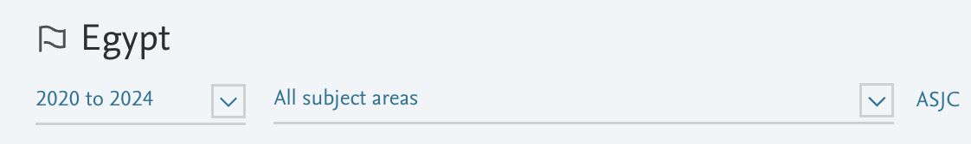
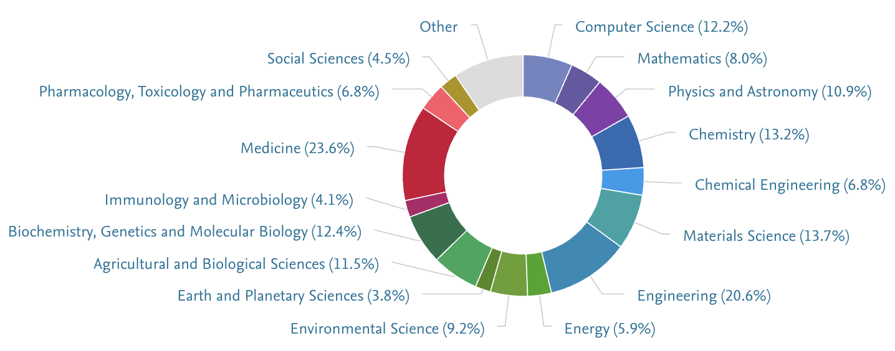
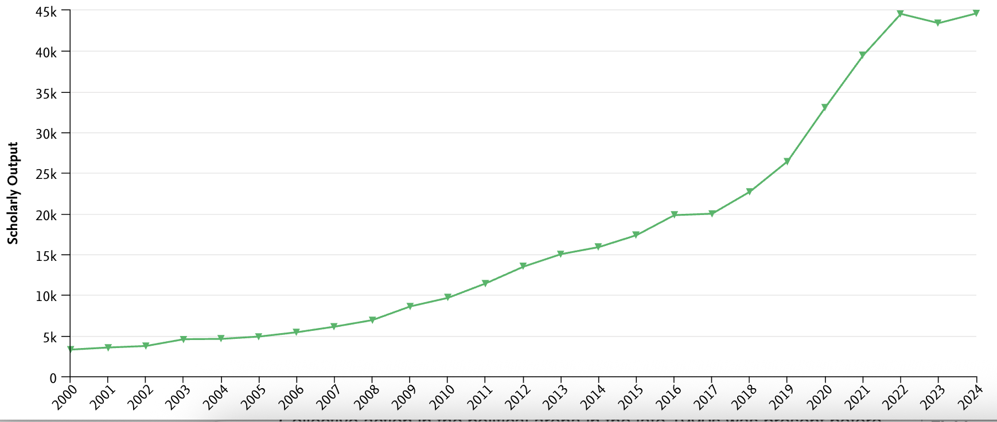
Source: SciVal, Elsevier. Data exported 20 Jun 2025 (Scopus coverage 2020–2024)
Notes:
Egyptian Portfolio (2020-24)
Twin engines: Medicine leads with 23.6% of publications and Engineering follows at 20.6%, reflecting national priorities in health services and infrastructure.
Applied STEM depth: Materials Science 13.7%, Chemistry 13.2%, and Computer Science 12.2% support renewable-energy, manufacturing, and digital-transformation agendas.
Life-science capacity: Biochemistry/Genetics 12.4% and Agri-Biological Sciences 11.5% underpin food security and biotech initiatives along the Nile Valley.
Environmental lens: Environmental Science contributes 9.2%, addressing water scarcity and climate adaptation; Energy research adds 5.9%.
Physics & maths fundamentals: Physics & Astronomy 10.9% and Mathematics 8.0% bolster Egypt’s emerging space and data-analytics programs.
Trajectory: Inset chart shows a sharp rise since 2015—nearly quadrupling total output—driven by new research universities and expanded R&D funding.

Slide 19
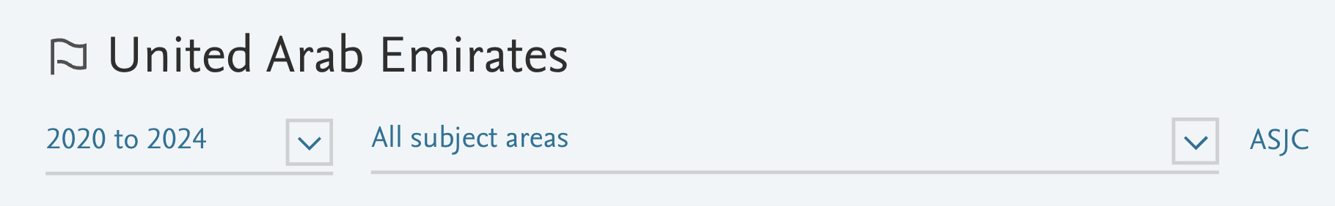
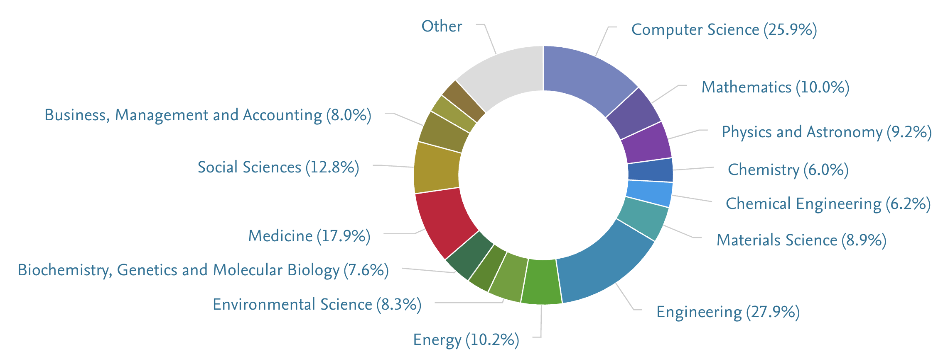
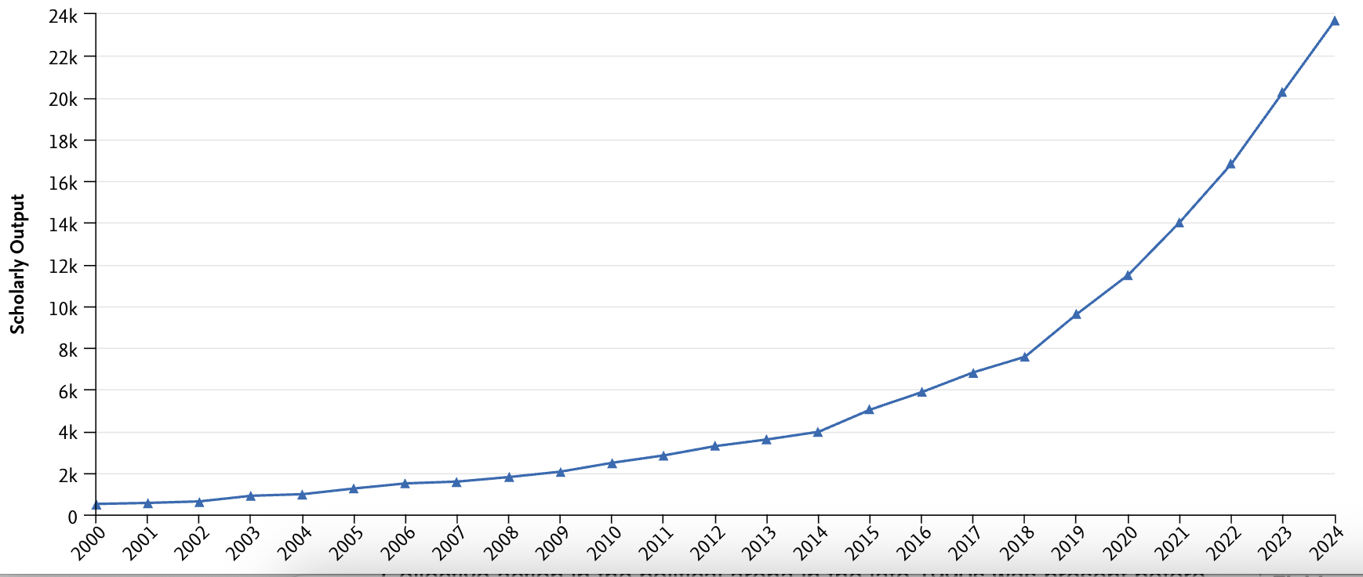
Source: SciVal, Elsevier. Data exported 20 Jun 2025 (Scopus coverage 2020–2024)
Notes:
UAE Portfolio (2020-24)
High-tech core: Engineering leads with 27.9% of publications, closely followed by Computer Science at 25.9%—evidence of the UAE’s push into AI, aerospace, and smart-city technologies.
STEM depth: Mathematics (10.0%), Physics & Astronomy (9.2%), Materials Science (8.9%), Chemistry (6.0%) and Chemical Engineering (6.2%) support advanced manufacturing, space missions, and clean-tech initiatives.
Health & life sciences: Medicine contributes 17.9%, while Biochemistry/Genetics adds 7.6%, aligning with the country’s growing biotech and precision-health sectors.
Sustainability focus: Energy research accounts for 10.2% and Environmental Science 8.3%, reflecting large investments in renewables, hydrogen, and desert-ecosystem studies.
Socio-economic insight: Social Sciences (12.8%) and Business/Management (8.0%) inform policy, entrepreneurship, and diversification from oil.
Trajectory: The inset chart shows an exponential climb since 2015—research output has more than quintupled—driven by new research universities, generous R&D funding, and international faculty recruitment.

Slide 20
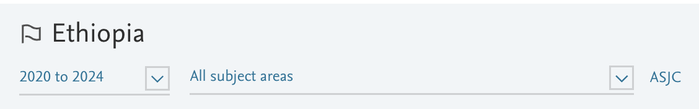
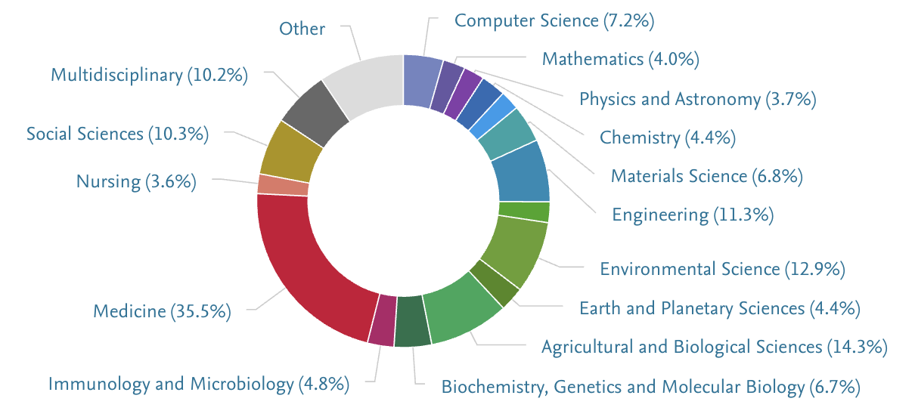
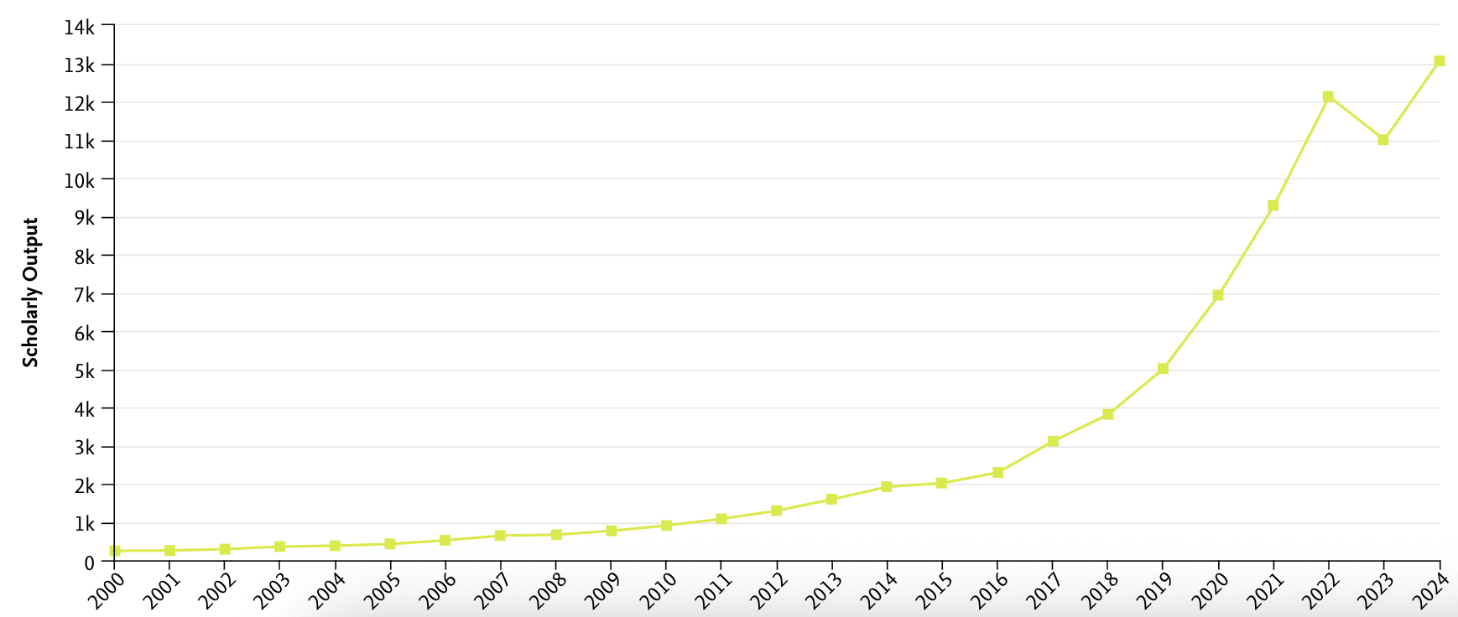
Source: SciVal, Elsevier. Data exported 20 Jun 2025 (Scopus coverage 2020–2024)
Notes:
Ethiopian Portfolio (2020-24)
Health-centred output: Medicine dominates at 35.5 %, supported by Immunology & Microbiology (4.8 %) and Nursing (**3.6 %)—a reflection of Ethiopia’s focus on infectious-disease control and primary healthcare.
Food & environment priorities: Agricultural & Biological Sciences (14.3 %) and Environmental Science (12.9 %) address food security, land management, and climate resilience across diverse agro-ecological zones.
Engineering & tech emergence: Engineering accounts for 11.3 %, Computer Science 7.2 %, and Materials Science 6.8 %, signalling early but fast-growing capacity in infrastructure and digital innovation.
Knowledge for development: Social Sciences (10.3 %) and Multidisciplinary research (10.2 %) inform policy on poverty reduction, governance, and sustainable development.
Trajectory: The inset graph shows an exponential rise since 2018—publication volume has more than tripled—indicating rapid expansion of the national research ecosystem driven by new universities and international partnerships.

Slide 21
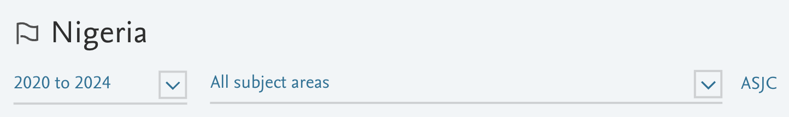
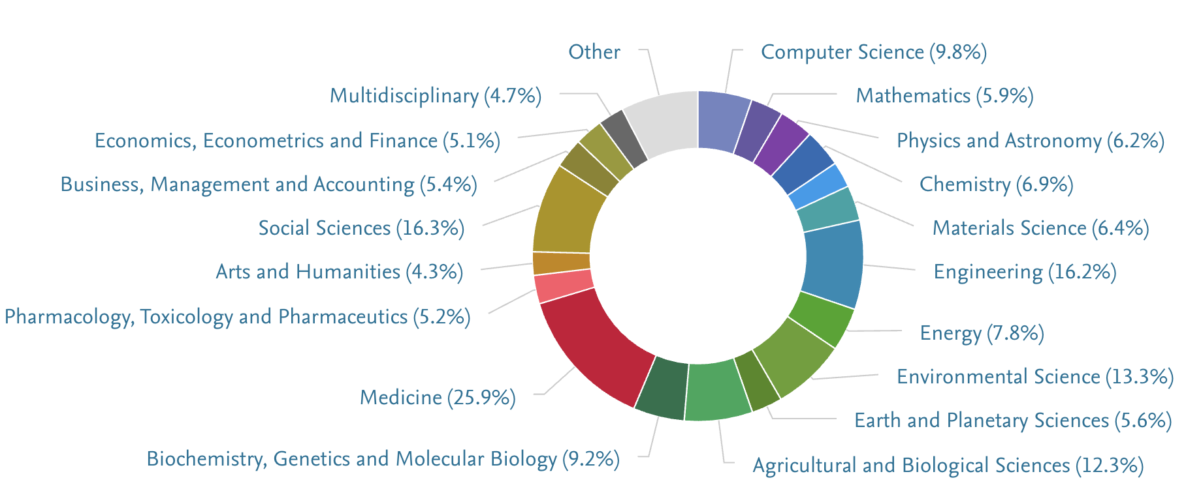
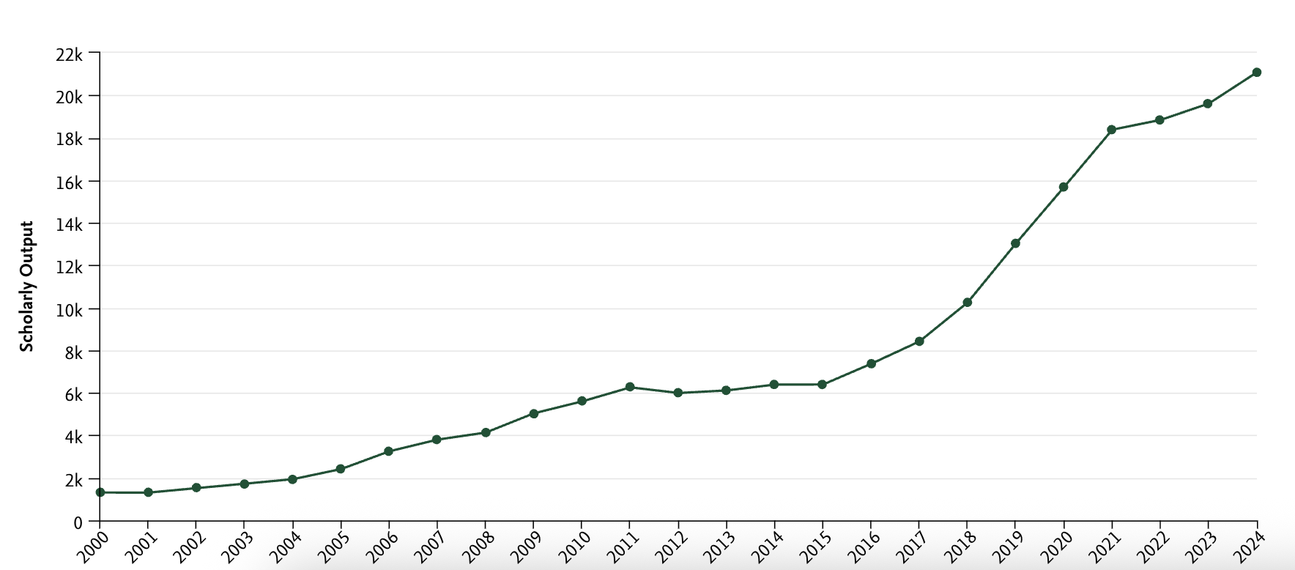
Source: SciVal, Elsevier. Data exported 20 Jun 2025 (Scopus coverage 2020–2024)
Notes:
Nigerian Portfolio (2020-24)
Health & society front-runners: Medicine accounts for 25.9 % of publications, while Social Sciences contribute 16.3 %, mirroring national priorities in public health and socio-economic development.
Green & food agenda: Environmental Science (13.3 %) and Agricultural & Biological Sciences (12.3 %) focus on climate resilience, soil restoration, and food security across diverse agro-ecological zones.
Emerging tech base: Engineering (16.2 %) and Computer Science (9.8 %) signal rapid growth in infrastructure, telecoms, and fintech innovation.
Applied STEM breadth: Chemistry (6.9 %), Materials Science (6.4 %), Physics & Astronomy (6.2 %), and Energy research (7.8 %) support Nigeria’s goals in petrochemicals, renewables, and space science.
Life-science capacity: Biochemistry, Genetics & Molecular Biology add 9.2 %, underpinning vaccine production and disease-genomics work.
Trajectory: Output has surged since 2018—nearly tripling by 2024—driven by federal R&D funds, new research hubs, and expanded university enrolment.

Slide 22
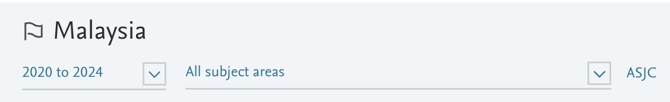
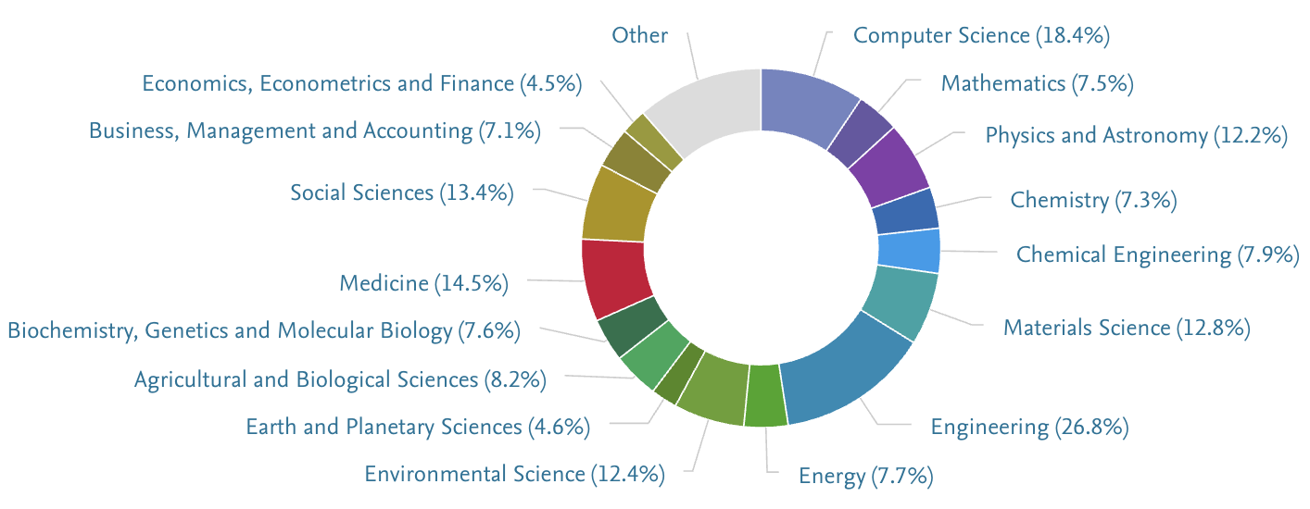
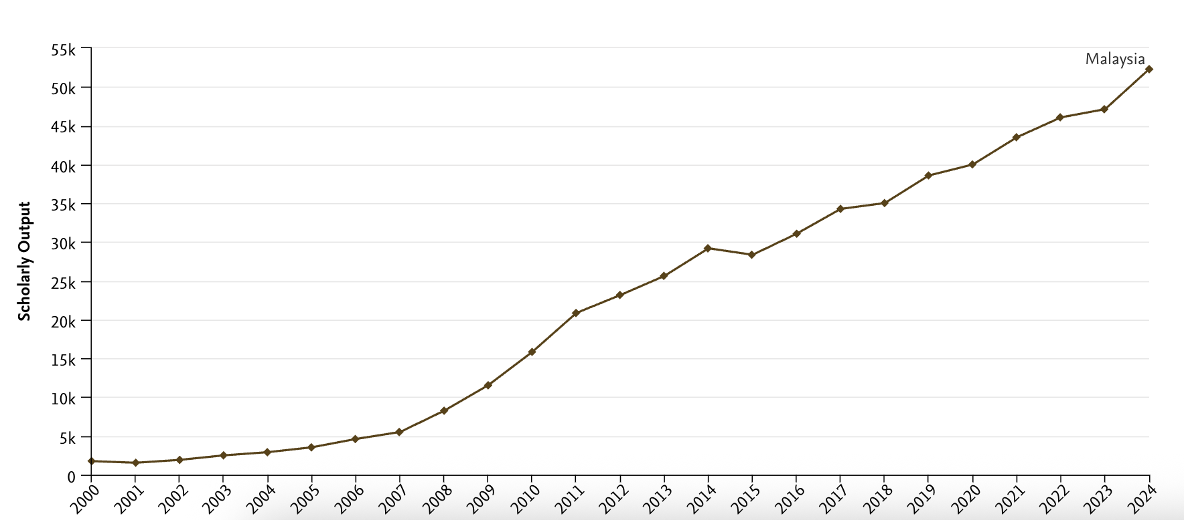
Source: SciVal, Elsevier. Data exported 20 Jun 2025 (Scopus coverage 2020–2024)
Notes:
Malaysian Portfolio (2020-24)
High-tech spine: Engineering dominates at 26.8 %, with Computer Science 18.4 %, Materials Science 12.8 %, and Physics & Astronomy 12.2 %—mirroring Malaysia’s role in electronics, semiconductors, and aerospace supply chains.
Sustainability thrust: Environmental Science contributes 12.4 %, Energy 7.7 %, and Agricultural & Biological Sciences 8.2 %, supporting national goals for green growth, palm-oil sustainability, and climate resilience.
Health & biotech: Medicine accounts for 14.5 %, while Biochemistry/Genetics adds 7.6 %, reflecting investments in vaccines, tropical-disease research, and precision health.
Socio-economic insight: Social Sciences (13.4 %), Business/Management (7.1 %), and Economics/Finance (4.5 %) inform digital-economy policy and industrial diversification.
Trajectory: Inset chart shows a smooth, near-linear rise—publications have more than quadrupled since 2010—indicating a steadily expanding research ecosystem aligned with Malaysia’s high-income transition.

Slide 23
Intra-BRICS-Plus Co-Authorship Matrix – Share of Each Country’s Scholarly Output (2019 – 2024)
Country | China | India | Russian Federation | Brazil | Iran | South Africa | Indonesia | Egypt | United Arab Emirates | Ethiopia | Average
China | 0,0% | 0,6% | 0,4% | 0,2% | 0,3% | 0,2% | 0,1% | 0,3% | 0,1% | 0,0% | 0,2%
India | 2,0% | 0,0% | 0,7% | 0,6% | 1,0% | 0,7% | 0,3% | 0,7% | 0,7% | 0,5% | 0,8%
Russian Federation | 3,2% | 1,5% | 0,0% | 0,7% | 0,6% | 0,4% | 0,2% | 0,6% | 0,3% | 0,1% | 0,8%
Brazil | 2,1% | 1,7% | 0,9% | 0,0% | 0,7% | 1,0% | 0,2% | 0,4% | 0,3% | 0,1% | 0,8%
Iran | 3,5% | 2,1% | 1,0% | 0,9% | 0,0% | 0,6% | 0,3% | 0,7% | 0,4% | 0,1% | 1,1%
South Africa | 5,8% | 5,6% | 1,5% | 2,7% | 1,3% | 0,0% | 0,6% | 1,1% | 1,1% | 1,1% | 1,0%
Indonesia | 1,3% | 1,5% | 0,4% | 0,4% | 0,4% | 0,4% | 0,0% | 0,4% | 0,3% | 0,1% | 0,6%
Egypt | 7,1% | 5,0% | 1,9% | 1,1% | 1,4% | 0,9% | 0,5% | 0,0% | 2,9% | 0,3% | 2,4%
United Arab Emirates | 8,0% | 11,4% | 2,0% | 2,0% | 2,1% | 2,3% | 1,0% | 7,1% | 0,0% | 0,4% | 4,0%
Ethiopia | 4,2% | 13,7% | 0,7% | 1,0% | 1,1% | 4,1% | 0,8% | 1,2% | 0,7% | 0,0% | 3,0%
Source: SciVal, Elsevier. Data exported 15 Mar 2025 (Scopus coverage 2019–2024)
Notes:
Collaboration density is modest: Core BRICS countries co-author < 4% of their papers with any single partner; averages hover below 1%.
China dominates the network: It is a top partner for almost all members, contributing up to 8% of the UAE’s and 7% of Egypt’s output.
India acts as a secondary hub: It leads bilateral shares for Ethiopia (14%), UAE (11%) and Iran (2%), while keeping its own partnerships diffuse.
Established BRICS (Russia, Brazil, South Africa): Maintain balanced yet low bilateral shares (~1%).
Newer entrants (UAE, Egypt, Ethiopia): Rely heavily on the larger BRICS for visibility, posting averages of 4%, 2.4% and 3%, respectively.
Opportunity: More exchange programs and joint grants among the larger BRICS nations could spark much stronger cooperation and help newer members climb faster.

Slide 24
Rank Order of Key Collaboration Partners for BRICS-Plus Countries (2019 – 2024)
 | China | India | Russian Federation | Brazil | Iran | South Africa | Indonesia | Egypt | United Arab Emirates | Ethiopia
China | 100 | 4 | 3 | 10 | 3 | 7 | 9 | 3 | 5 | 5
India | 13 | 100 | 7 | 14 | 9 | 6 | 7 | 4 | 2 | 1
Russian Federation | 19 | 18 | 100 | 26 | 16 | 27 | 24 | 17 | 23 | 43
Brazil | 31 | 21 | 24 | 100 | 23 | 15 | 22 | 23 | 25 | 29
Iran | 26 | 23 | 28 | 34 | 100 | 30 | 31 | 21 | 22 | 28
South Africa | 35 | 15 | 41 | 24 | 33 | 100 | 25 | 29 | 18 | 6
Indonesia | 50 | 41 | 64 | 58 | 55 | 60 | 100 | 54 | 53 | 38
Egypt | 24 | 16 | 29 | 45 | 27 | 43 | 32 | 100 | 6 | 26
United Arab Emirates | 40 | 19 | 52 | 53 | 39 | 42 | 39 | 8 | 100 | 40
Ethiopia | 61 | 29 | 88 | 86 | 74 | 38 | 57 | 76 | 72 | 100
Number 1 | United States | United States | United States | United States | United States | United States | Malaysia | Saudi Arabia | United States | India
Number 2 | United Kingdom | Saudi Arabia | Germany | United Kingdom | Canada | United Kingdom | Japan | United States | India | United States
Number 3 | Australia | United Kingdom | China | Spain | China | Australia | Australia | China | United Kingdom | United Kingdom
Source: SciVal, Elsevier. Data exported 15 Mar 2025 (Scopus coverage 2019–2024)
Notes:
Who tops the list? Across these BRICS-Plus members, the United States is still the #1 co-author for nearly everyone, underscoring its continuing pull in global research.
Second tier movers China and India regularly appear in the #2–#3 slots, highlighting their growing influence as alternative collaboration hubs.
Take-home message While South-South links are expanding, North-South ties—especially with the U.S.—remain dominant; boosting intra-BRICS partnerships will be key to balancing the network

Slide 25
Beyond Co-Authorship: Where the Collaboration Happens
Shared authorship is our starting signal
It shows that researchers across BRICS-Plus nations are publishing together and trust each other’s labs.
But what are they working on?
The next slides reveal four priority arenas where those co-authorship ties translate into concrete joint projects and policy agendas:
Clean Energy & Climate Solutions
Health, Vaccines & Food Systems
Digital & Artificial Intelligence

Slide 26
Energy & Climate Collaboration
Energy transition R&D: green hydrogen, large-scale solar & wind, grid storage.
Key partners: China ↔ India ↔ Russia ↔ Brazil, plus hydrocarbon-rich newcomers (Iran, UAE).
Joint objective: secure, low-carbon energy mix for all BRICS-Plus economies.
Climate resilience: shared modelling of extreme events and carbon-capture pilots.
Notes:
Context. BRICS-Plus members are investing together in green hydrogen, utility-scale solar and wind parks, advanced battery storage — and, in Brazil’s case, world-class biofuel and biomass programs.
Partnerships. China and India lead many demonstration projects; Russia contributes grid expertise; Iran and the UAE channel capital from their energy revenues; Brazil offers decades of know-how in sugar-cane ethanol, biodiesel, and emerging offshore wind and biomass technologies.
Shared purpose. Coordinating efforts lowers costs, improves energy security, and amplifies the bloc’s voice in global climate negotiations.
Key message. With Brazil’s proven success in biofuels complementing new hydrogen, solar, and wind ventures, the group is well positioned to secure clean, affordable energy and gain a lasting competitive edge.

Slide 27
Health, Vaccines & Food Systems
Public-health networks: cross-country disease surveillance and data sharing.
Vaccine co-development: technology transfer deals linking China, India, Brazil & South Africa.
Food-system research: climate-smart agriculture, healthy-diet supply chains (Brazil, India, Indonesia, Egypt).
Goal: boost regional self-sufficiency in health security and nutrition.
Notes:
Public-health network. Since COVID-19, laboratories in Brazil, South Africa, China, and India exchange disease data.
Vaccine pipeline. China supplies mRNA know-how, India mass-produces, Brazil streamlines regulation, and South Africa handles final packaging—forming a complete chain within the bloc.
Food research. Projects on climate-smart crops and efficient supply chains unite Brazil, India, Indonesia, and Egypt.
Key message. Stronger cooperation in health and make the BRICS-Plus region self-sufficiente in both health security and nutrition.

Slide 28
Digital & AI Frontiers
“AI Alliance” initiatives: joint large-language models and regulatory sandboxes (China & Russia leading).
Digital-infrastructure build-out: 5G/6G corridors and satellite-based internet for remote areas.
Skills pipelines: co-funded graduate programs and researcher exchanges in data science.
Aim: establish the BRICS-Plus as a competitive tech bloc while narrowing the digital divide.
Notes:
AI cooperation. China and Russia are leading the development of multilingual large-language models, with contributions from partner countries to capture local contexts and needs.
Brazil’s PBIA. In 2024, Brazil approved the Brazilian Artificial Intelligence Plan (PBIA), which sets national priorities for responsible AI, open data, and capacity-building. PBIA resources are now being linked to the broader BRICS-Plus “AI Alliance,” giving researchers common standards and access to funding across the bloc.
Connectivity push. Investments in 5G/6G corridors and low-orbit satellites aim to bring fast internet to remote areas—from the Amazon to the Gobi Desert—so that every member can join shared research platforms.
Talent exchange. Scholarships, hackathons, and shared super-computers allow a student in Pretoria or Pelotas to run code on clusters in Shenzhen or São Paulo in real time.
Key message. By aligning national plans like Brazil’s PBIA with collective AI initiatives, the BRICS-Plus can narrow the digital divide, influence global standards, and convert knowledge into inclusive economic growth.

Slide 29
Strategic Takeaways
South-South knowledge flow is accelerating, yet still complements strong North-South ties.
Energy, health, AI and food resilience form the core pillars of present collaboration.
Policy levers: expand joint funds, mobility schemes and shared research infrastructure to deepen intra-bloc partnerships and lift newer members faster.
Notes:
South-South links are growing, though many members still collaborate heavily with the United States and Europe.
Four priority fields — energy, health, AI, and food — account for most joint work and promise the quickest impact.
Recommended actions:
• Expand joint research funds with matching finance.
• Simplify visas and fellowships to move people and ideas more easily.
• Share expensive facilities—such as synchrotrons, biobanks, and high-performance computers—under open access rules.
Looking ahead. Stronger collaboration can speed up innovation, raise global influence, and deliver practical benefits to the citizens of every member country.

Slide 30
Recommended actions
Expand joint research funds with matching finance.
Simplify visas and fellowships to move people and ideas more easily.
Share expensive facilities – such as synchrotrons, biobanks, and high-performance computers – under open access rules.
Notes:
“Recommended Actions” (≈ 45 s)
“Here’s the practical checklist to turn ambition into impact:
Expand joint research funds.
– Match funding 50-50 between host and partner agencies, so every dollar mobilised at home doubles instantly.
– Prioritise multi-country calls in the four focus areas we covered—energy, health, AI, and food systems.
Simplify mobility.
– Fast-track visas for researchers, create a single BRICS-Plus fellowship portal, and recognise each other’s security clearances.
– Target: move a scientist and their samples across borders in under 10 days, not the current 10 weeks.
Share big-ticket facilities.
– Synchrotrons, biobanks, petascale computers—they’re too expensive to duplicate in every country.
– Adopt open-access rules: merit-based beam-time, transparent fees, and shared data repositories.
– Example: Brazil’s Sirius synchrotron already allocates 25 % of beam hours to external BRICS users—let’s scale that model.
Bottom line: if we pool money, people, and infrastructure under clear, reciprocal rules, the whole network accelerates—and each member gets a bigger scientific return on every unit of investment.”

Slide 31


Thank you
Odir Dellagostin
Federal University of Pelotas
President of FAPERGS

