Slide 1



Neural Basis of Moral Emotions, Rewards and Altruism
From Scanners to the Real World
Reunião Magna – ABC
Museu do Amanhã, 2017
SESSÃO CIENTÍFICA: “CÉREBRO, ENVELHECIMENTO E CAPACIDADE COGNITIVA”
Jorge Moll Neto
Cognitive & Behavioral Neuroscience & Neuroinformatics
D’Or Institute for Research and Education (IDOR)
www.idor.org www.moll-lab.org

Slide 2
No conflicts of interest

Slide 3
Outline
Neuroscience of emotions, rewards and moral cognition
Functional imaging of moral emotions and impairments in neuropsychiatry
Real-time neurofeedback of moral emotions using functional MRI
Emerging clinical applications
Perspectives

Slide 4

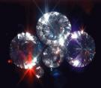
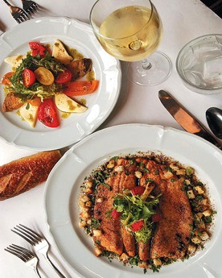



Rewards and immediate self-interest

Slide 5
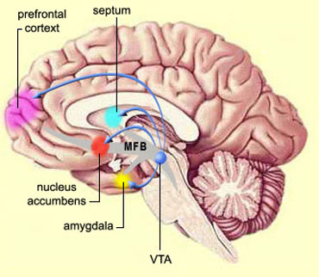
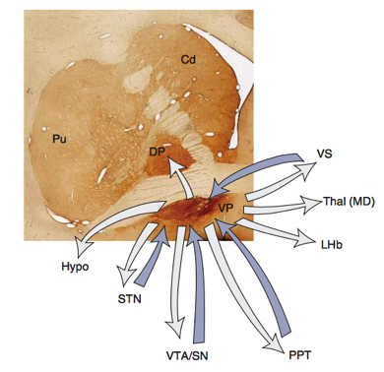
Reward system (“valuation”)
Associated higher-level cognitive mechanisms
→ Goal, prediction, comparison, ambiguity, prospective evaluation
SG
OFC
Schultz W. NRN, 2000
Haber & Knutson, NPP2010

Slide 6
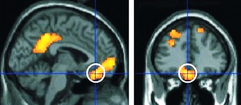

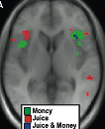
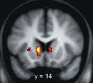
Brain imaging and economic value
Medial orbitofrontal cortex
Amygdala
Insula
Striatum
Kim et al., 2010; Knutson et al., 2001; Levy & Glimcher, 2012

Slide 7
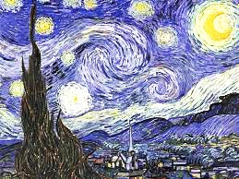
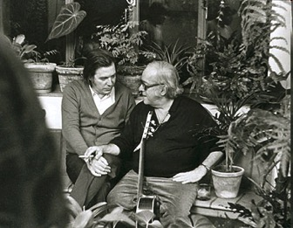
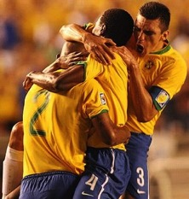
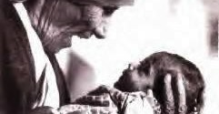
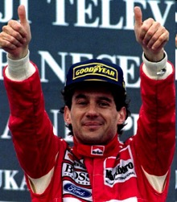


Moral emotions and social values

Slide 8
MORALITY
SETS OF CUSTOMS AND VALUES ADOPTED BY INDIVIDUALS AND SOCIETIES TO GUIDE SOCIAL BEHAVIOR
MORAL MOTIVATION
THE ABILITY TO BE MOTIVATED BY SOCIO-CULTURAL NORMS OR OTHER PEOPLE’S NEEDS
→ Moral behavior requires (1) the knowledge about the needs of others (SOCIAL KNOWLEDGE) and about specific sociocultural norms and (2) the motivation to behave in such ways

Slide 9
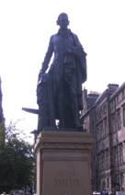
What motivates us to behave morally?
“Moral sentiments”
Adam Smith & David Hume: 18th century Scottish Enlightenment
Modern psychology (Tangney, 2007, Eisenberg, 2000): “Moral emotions”, e.g. guilt, compassion, pride, gratitude, contempt
Moral motivations tied to
social action in specific context
of sequence of events
abstract moral value
“Your mother calls you one night telling you she was not feeling well. You did not take her seriously, and the next day she died”
→ Guilt
in 80% of Brazilian sample (Moll et al., 2007)
“You act dishonestly towards your best friend”
→ Guilt
in 73% of US sample (Zahn et al., 2009)

Slide 10
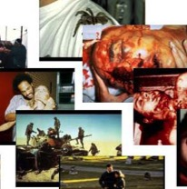
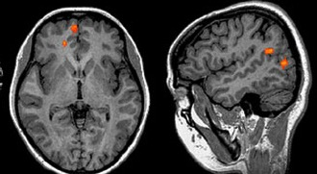
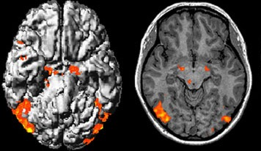
Functional MRI of implicit moral sentiments
Indignation
Compassion
Fear
Disgust
Moral unpl. vs. Unpleasant Moral unpl. ∩ Unpleasant
BA10 STS
Amygd. Midbrain
Moll, de Oliveira-Souza, Eslinger et al. J Neurosci, 2002

Slide 11
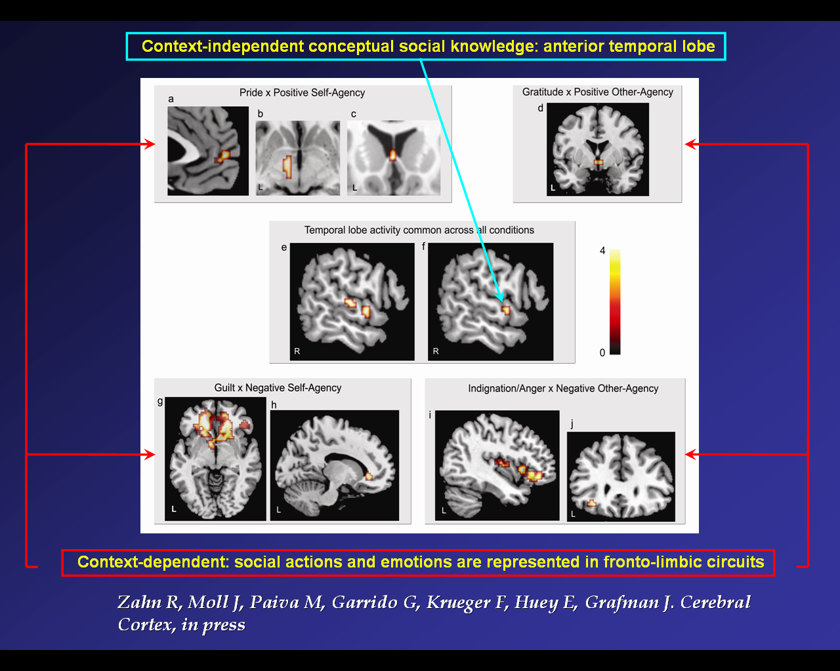
The right ATL & social knowledge
Contextualized social concepts (values) → moral sentiments
e.g. [YOU] acted [stingily or generously] towards [BEST FRIEND]
Right Anterior Temporal Lobe
across all condition
Other fronto-subcortical areas
→ different moral sentiments
Zahn R, Moll J, Paiva M, Garrido G, Krueger F, Huey E, Grafman J.
Cerebral Cortex, 2009

Slide 12
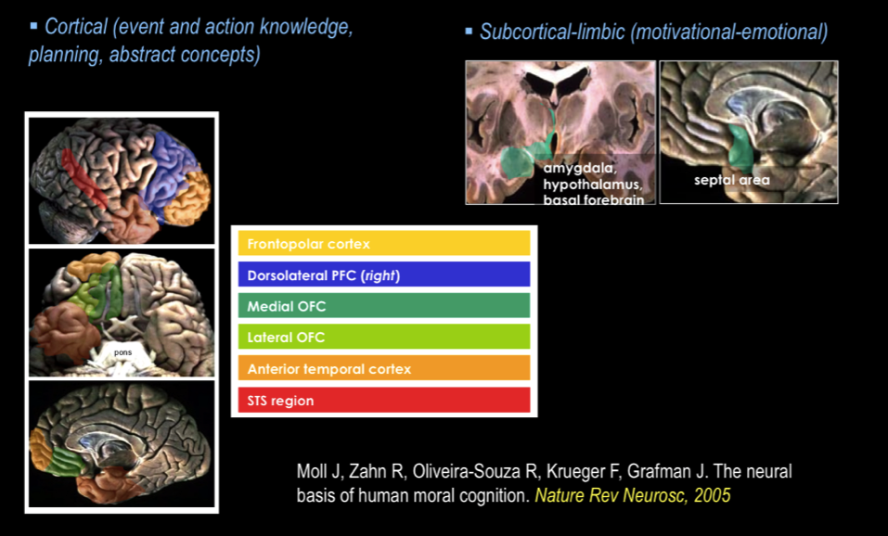
  Brain regions consistently involved in moral cognition, emotion and behavior: lesion & fMRI

Slide 13
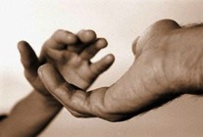

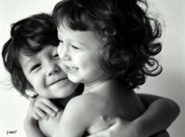
SOCIAL ATTACHMENT
Establishment of strong social bonds
Promotion of cooperation and altruism
Social cohesion
Social affiliation → tender/affectionate feelings
Insel and Young, 2001; Depue and Morrone-Strupinsky, 2005; Moll & Schulkin, 2009

Slide 14
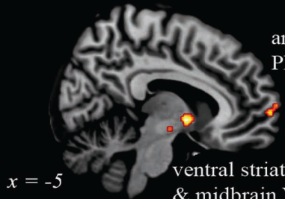
Guilt and compassion: affiliative (“social attachment”) system
“Your mother calls you one night telling she was not feeling well. You did not take her seriously, and the next day she died.”
(guilt)
“You went with a friend to a restaurant. When you passed by the kitchen, you saw rats crawling all over the place.”
(indignation)
Frontopolar cortex
GUILT & COMPASSION
Septo-hypothalamic area
Moll et al. Soc Neurosci, 2007

Slide 15
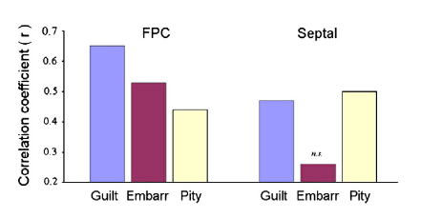
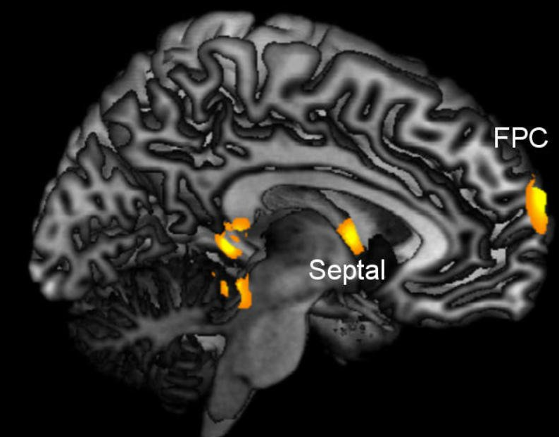
Impaired prosocial sentiments in behavioral variant frontotemporal dementia
Regions showing reduced PET-FDG uptake correlated with the moral emotion task
Specific impairments of prosocial sentiments in patients with Fronto-Temporal Dementia
Moll J, Zahn R, de Oliveira-Souza R, et al. NeuroImage, 2011

Slide 16
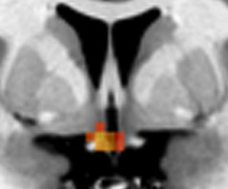
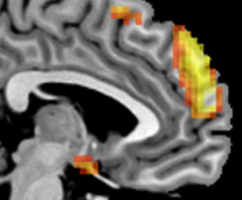
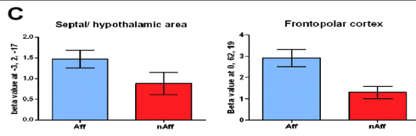
Neural signature of affiliative emotions (tenderness/affection)
AFFILIATIVE vs NON-AFFILIATIVE
Septal-medial preoptic hypothalamus & Frontopolar cortex
Moll et al., J Neurosci 2012
PERCEIVING FAMILY AS A COHESE SOCIAL GROUP
Subgenual cingulate cortex
Rusch et al., Soc Neurosci, 2014

Slide 17
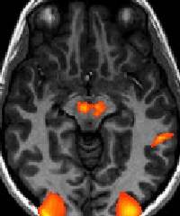
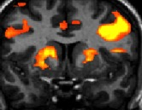
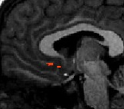
Charitable donations – fMRI study
Pure $ reward and donation vs baseline
Mesolimbic reward system:
self reward
VTA
STR
Costly and non-costly donation vs. pure $ reward
Subgenual cortex / septal region: attachment to societal causes
Subgenual / septal area
Moll J, Krueger F, Zahn R, et al. PNAS, 2006

Slide 18
Neurofeedback: self-regulation of brain activity when provided with feedback information about one’s own physiological responses
Are humans able to modulate their own neural responses arising from moral emotions?

Slide 19
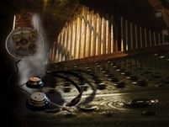

  Philip K. Dick: “Do Androids Dream of Electric Sheep?”(1968)
Ridley Scott: Blade Runner (1982)
The Penfield Mood Organ:“dialing”moods

Slide 20
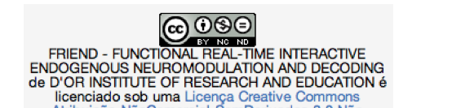
  Brain decoding and neurofeedback
  Pattern recognition methods in neuroimaging
  Inferring cognitive / psychological states
  Neurofeedback applications
Characterizing neural signatures and promoting adaptive neural/psychological states
Development of a real-time functional MRI and neurofeedback system:
FRIEND: Functional Real-time Interactive Endogenous Neuromodulation and Decoding. Free for non-commercial use.
Sato et al., Plos One, 2013
Basilio et al., Front in Behav Neurosc, 2014

Slide 21
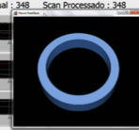
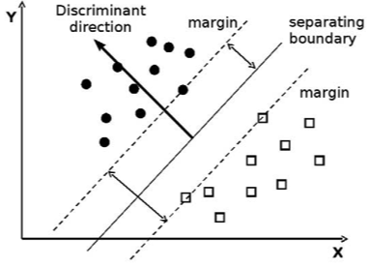
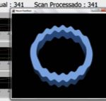
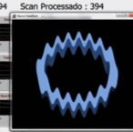
Discrimination between TENDERNESS and SELF-PRIDE associated with autobiographical memories (baseline = emotionally “NEUTRAL”)
24 participants, randomized to a NFB or control group
A hit with highest SVM projection
TENDERNESS.
Distance from hyperplane
A hit with mid-range SVM projection
SELF-PRIDE.
SUPPORT VECTOR MACHINE FOR PATTERN DECODING
Either error in classification or a hit with low SVM projections

Slide 22


Slide 23


Slide 24


Slide 25


Slide 31


Slide 33
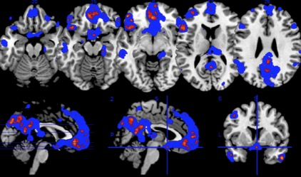
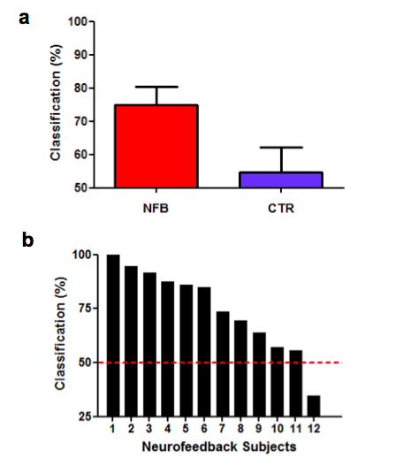
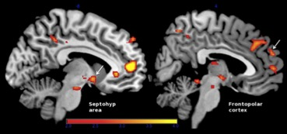
Neurofeedback and control groups: tenderness vs. pride (24ss)
Support Vector Machine (SVM) discriminant maps
BOLD increases associated with increased decoding across NFB sessions
Moll et al., Voluntary enhancement of neural signatures of affiliative emotion using FMRI neurofeedback. Plos One, 2014

Slide 34
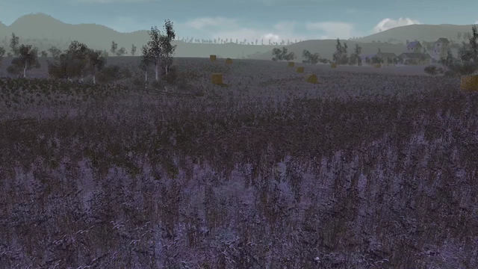

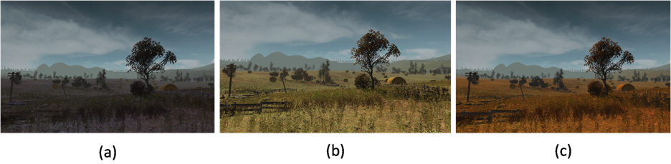
Virtual-reality based neurofeedback for emotional regulation
Bruno Mello, Julie Weingartner (PhD candidates): technical proof of concept study
Ways to induce vivid and stronger emotional states
“Gestaltic”: visual scenes, music, memory → unified feeling state
ANGUISH / DISTRESS EMOTIONALLY NEUTRAL STATE AFFECTION / AFFILIATIVE

Slide 35
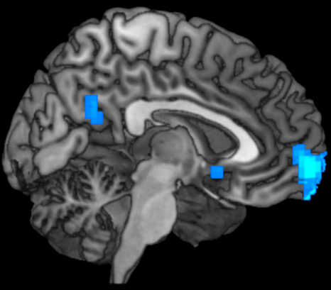
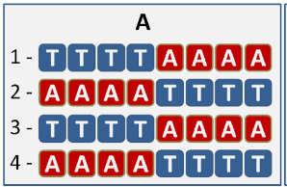
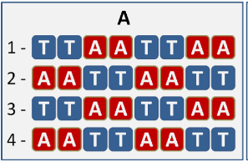
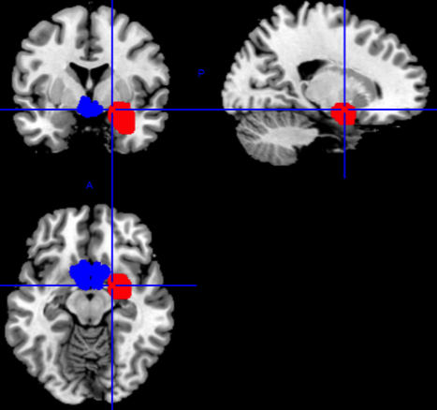
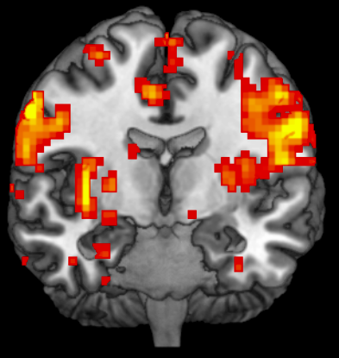

Virtual-reality based neurofeedback for emotional regulation
Regions of Interest (ROIs) or SVM for:
AFFECTION / AFFILIATIVE STATES
ANGUISH / DISTRESS STATES
ROI
SVM
Septal / medial preoptic hypothalamic area
Right amygdala
SVM training; GLM: FWE-corr
+
Associated networks comprising the:
mOFC, PCC
Insula, lOFC, DLPFC
Rio-Melbourne pilot study (with Murat Yucel & Valentina Lorenzetti)

Slide 36

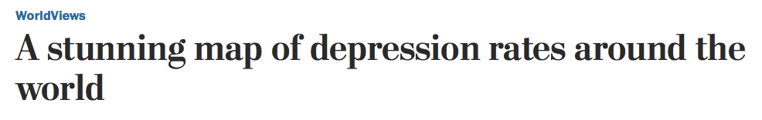


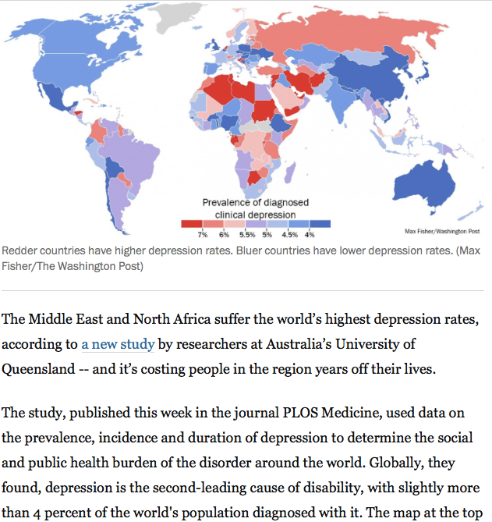



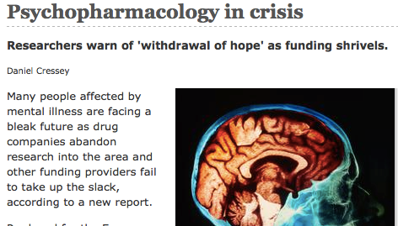
Need for new therapeutic options in psychiatry

Slide 37
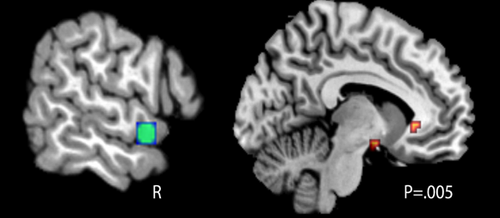
Searching for an fMRI signature of depression vulnerability: Guilt-selective functional decoupling in remitted major depression
control
group
Anterior
Temporal
remitted depression
Seed area
Subgenual
“You act dishonestly towards your best friend”
Remitted depression: lower coupling during
self-blame (guilt) versus other-blame (indignation)
S. Green, M. Lambon Ralph, J. Moll, J.W. Deakin, R. Zahn. Arch. Gen. Psychiatry, 2012
Notes:
37

Slide 38
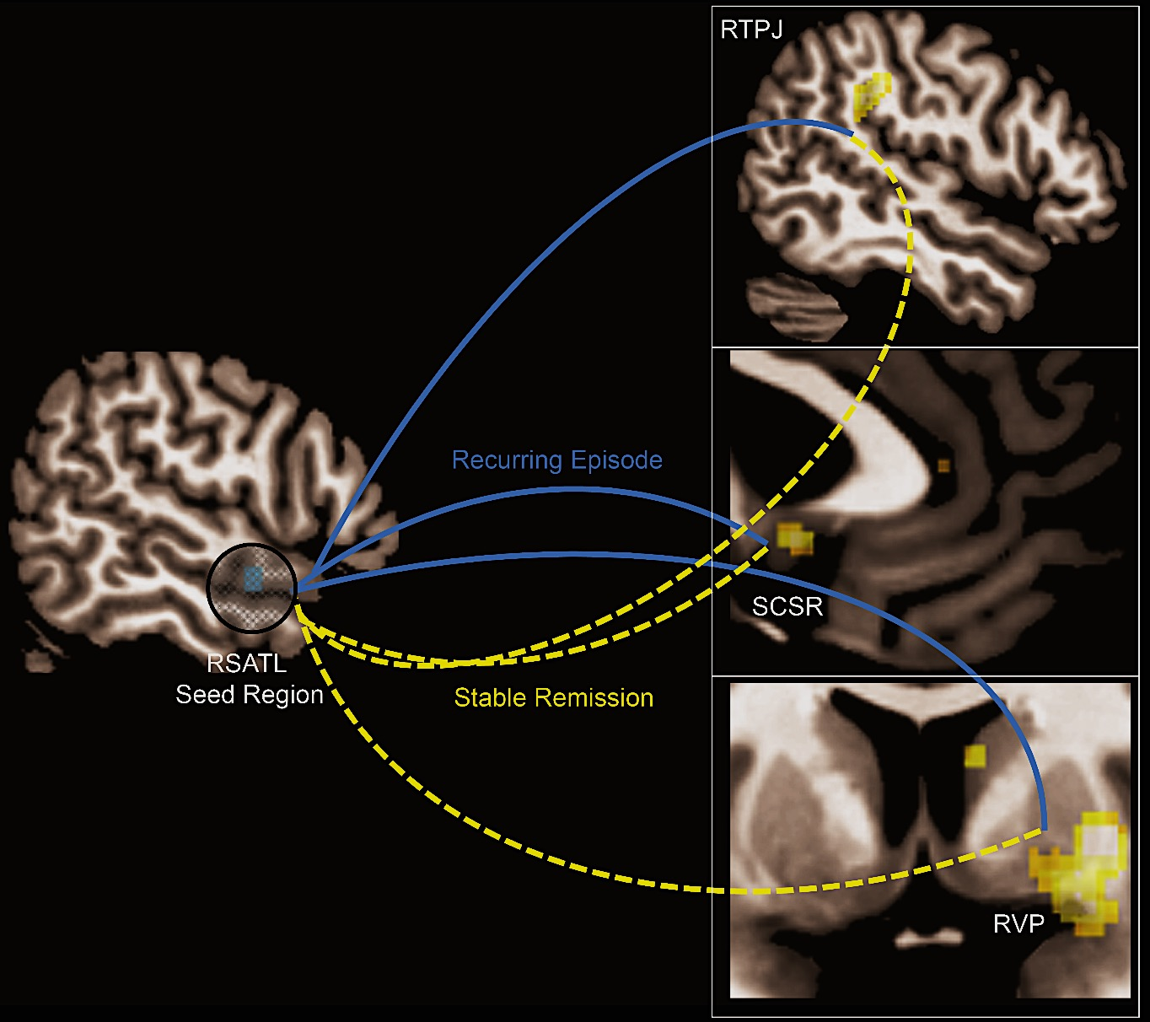



Self-blame-selective functional connectivity in remitted MDD
Does subgenual-ATL connectivty predict recurrence?
Ongur et al., 2003
Lower connectivity in individuals with high self-contempt bias irrespective of recurrence risk
Machine Learning-based prediction: 75% accurate
Higher connectivity in recurring MDD
Self-blaming vs. Other-blaming emotions
all patients medication-free (FWE-corr, P<.05, a priori SGC)
Lythe K., Moll J., Gethin J., Workman C., Green S., Lambon Ralph, M., Deakin J., Zahn R. JAMA Psychiatry (2015)
Notes:
38

Slide 39






Blame rebalance neurofeedback: proof-of-concept trial
Controlled, double-blind, technical proof-of-concept trial in major depressive disorder
Anterior
Temporal
Anterior
Temporal
Correlations between 10% most highly activated voxels in each region using sliding time window and controlling for signal drift and motion
Subgenual
Visual thermometer scale feedback
Zahn & Moll: http://clinicaltrials.gov/ct2/show/NCT01920490
Undergoing RCT in remitted MDD patients
(PI: Roland Zahn, PhD project: Tanja Jaeckle)

Slide 40
Prospects
Combining technologies – digital / mobile, portable EEG and near-infrared spectroscopy – to study social behavior in ecological settings
Use of virtual / augmented reality and games to boost ecological validity of the moral motivation approach in experimental and clinical studies
Refined neural models of human moral emotion, cognition and motivation: trait and state biomarkers / predictive models of behavior, symptoms, disease status and treatment response
Explore the full potential of neurofeedback using more powerful techniques (parallel fMRI acquisition, connectivity, hi-res) + computational models

Slide 41








Slide 42






Acknowledgements
Cognitive Neuroscience Unit and Neuroinformatics Workgroup, D’Or Institute for Research and Education (IDOR), Rio de Janeiro, Brazil
Ricardo de Oliveira Souza, Fernanda Tovar Moll, Ivanei Bramati, Rodrigo Basílio, Leonardo Fontenelle, Paulo Mattos, Griselda Garrido, Débora O. Lima, Patricia Bado, Julie Weingartner, Gil Sant’anna, Tiago Bortolini, Theo Marins, Joao Ascenso, Sebastian Hoefle, Bruno Mello
Centre for Affective Disorders, Department of Psychological Medicine, Institute of Psychiatry at King's College, London
Roland Zahn
Brain Injury Research & Cognitive Neuroscience Lab, Rehabilitation Institute of Chicago, & Psychiatry and Behavioral Sciences Dept., Northwestern University, Chicago
Jordan Grafman

